Slide 1

Sampling
Forms
Documentation
Notes:
INSERT NOTES HERE

Slide 2
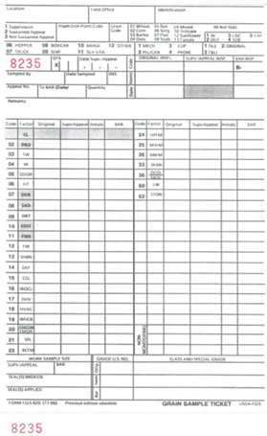
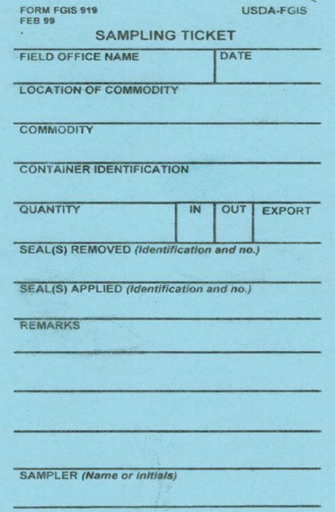
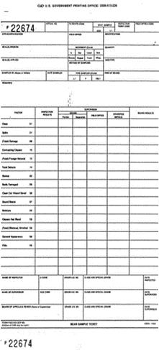
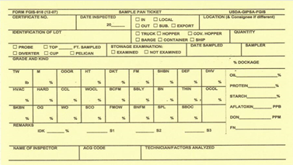
Objectives
Introduce and Review:
  Forms
  Work Records
  Official Instructions
  Common Mistakes
  Do’s and Don’ts
  The Official Certificate
  Links to Documents & Forms
  Questions

Slide 3
Forms and Letters
FGIS-907
    Used by applicant (Customer) to request service
FGIS-FGIS-991
    General Services Worksheet
      Compute and document checkweighing of sacked grain, rice, and pulses
FGIS-919
    Sampling Ticket
FGIS-920
    Grain Sample Ticket
FGIS-933
    Bean Sample Ticket

Slide 4
Forms and Letters Cont.
FGIS-982
    Pea and Lentil Sample Ticket
FGIS-992
    Services Performed Report for AMA products
FGIS-921
    Inspection Logs for Ships
Grain Ticket Envelope (GTE)
FGIS 918
    Sample Pan Ticket
FORM AD-3066
    Container Examination Worksheet

Slide 5
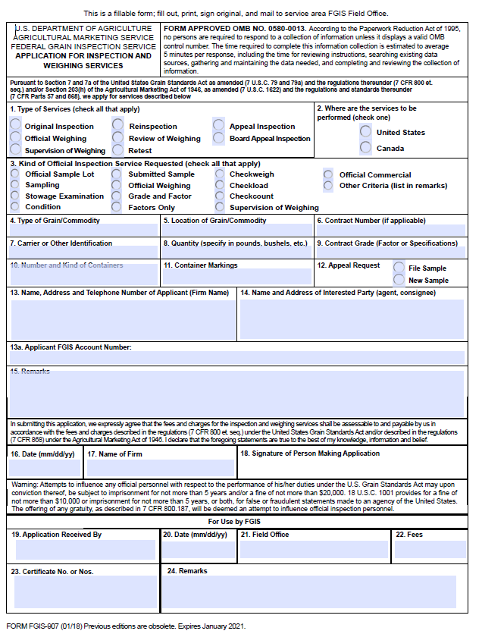
Form FGIS-907
Form FGIS-907
  Application for Inspection and Weighing Services
  Verbal requests are also acceptable

Slide 6
Form FGIS-991
Form FGIS-991
General Services Worksheet
Used to compute and document the official weight
Used when checkweighing:
  Sacked Grain
  Sacked Rice
  Sacked Pulses

Slide 7
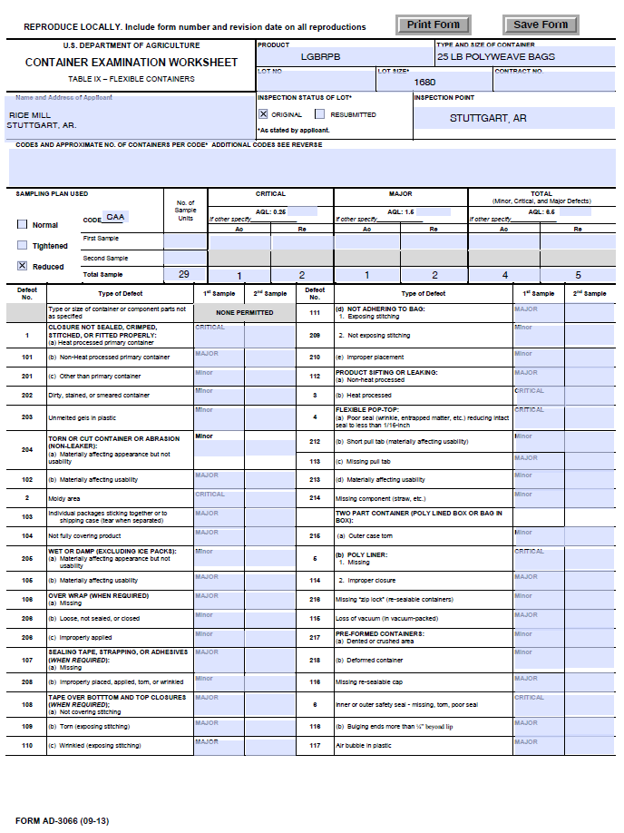
Form AD-3066
Form AD-3066
Container Examination Worksheet:
  Sacked Rice
  Bags in Bales
  Outer Containers with bags in bales

Slide 8

Form FGIS-933
Work Record for use while performing Inspection of Edible Beans

Slide 9
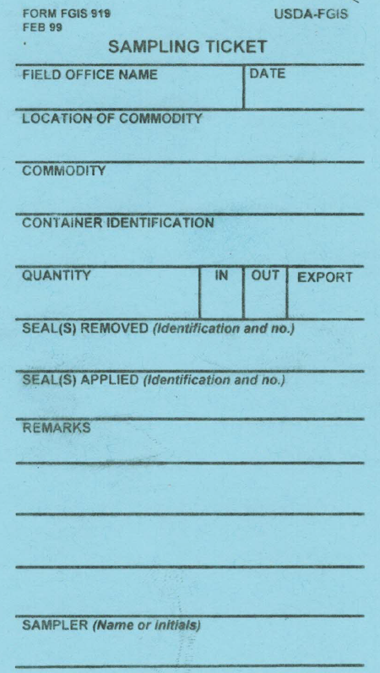
Form FGIS-919
Work record is used for sampling on location

Slide 10
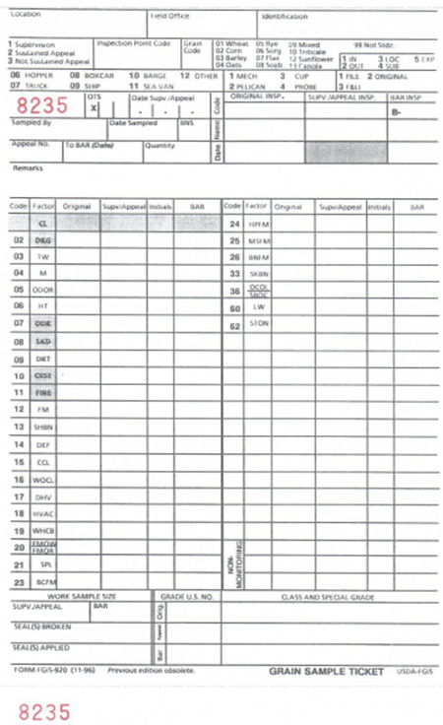
Form FGIS-920
Work record is used for reporting USGSA inspection results

Slide 11
Form FGIS-982
Work record is used for reporting Pea and Lentil inspection results

Slide 12
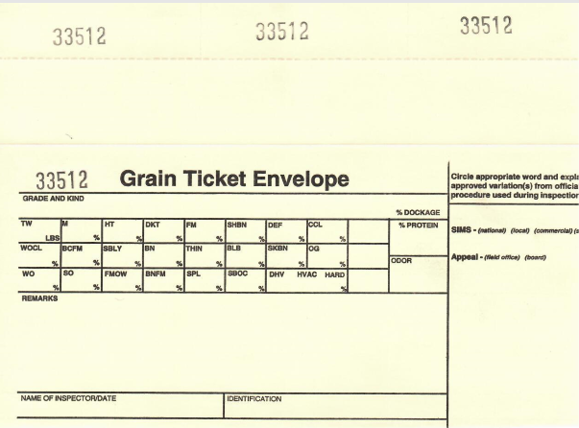
Grain Ticket Envelope
Work record used for SIMS and Appeals which original inspection results are reviewed in the blind

Slide 13
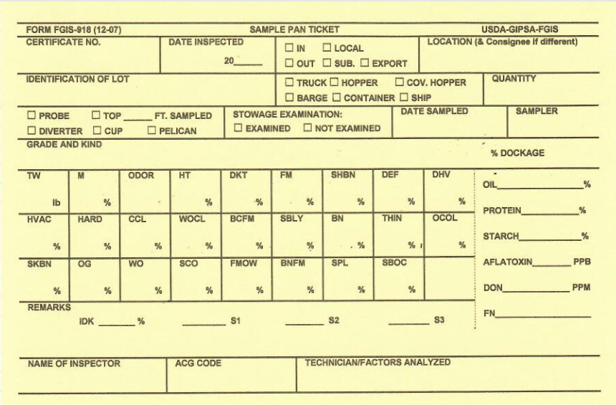
Sample Pan Ticket
Work record used to record inspection results in the field

Slide 14
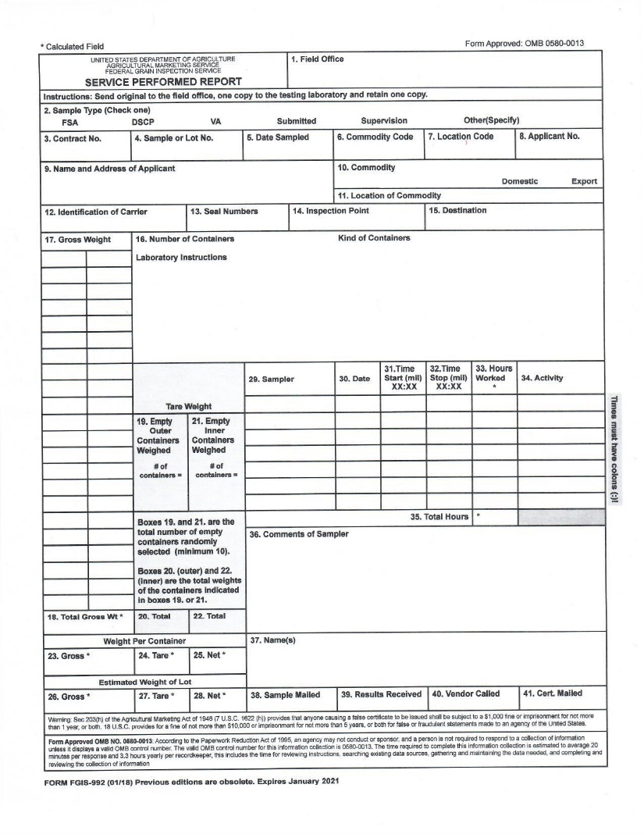
Form FGIS-992
Form FGIS-992
Service Performed Report
AMA Services
Carriers other than vessels
Used when:
  Sampling
  Checkweighing
  Checkloading

Slide 15
Form FGIS-991
Form FGIS-991
General Services Worksheet
Used to compute and document the official weight
Used when checkweighing:
  Sacked Grain
  Sacked Rice
  Sacked Pulses

Slide 16
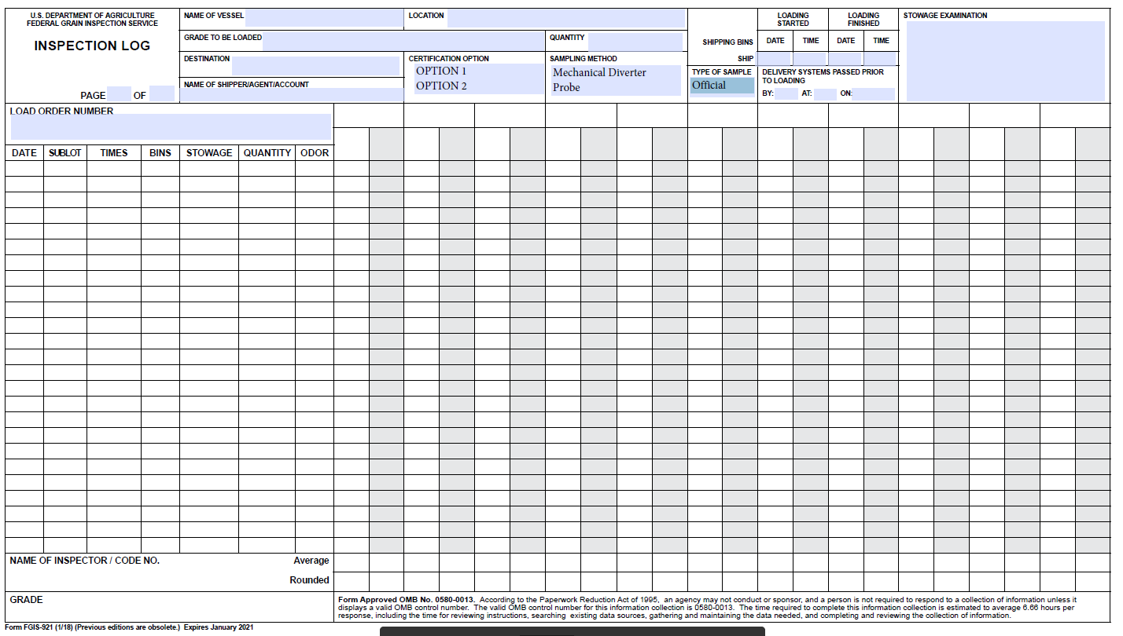
Form FGIS-921
Inspection Log for Ships
Work Record used to document prior-to-loading exams

Slide 17
Bribe Card
Bribe Card MUST be carried at all times
Provides vital information on what to do if you are offered a bribe
Be sure to carry one for your part of the country
  Card Front-All Regions
  Card Back-All Regions

Slide 18
Form FGIS-952
Work Record for use while performing Sanitation Inspection for Processed Products

Slide 19
Form FGIS-952-1
Work Record for use while performing Sanitation Inspection for Beans, Peas, and Lentils

Slide 20

Do’s and Don’ts
DO | DON'T
Write Clearly and Legibly and in ink | Submit Forms which are messy
Take your time | RUSH
Make sure to take All needed Paperwork | Black Out/Scratch Out a Mistake
Include any Travel, Stand-by, and Mileage Time along with Remarks, if applicable
Use Military Time in 15 minutes increments | Forget to bill hours worked if applicable
Double Check your work for ACCURACY | GUESS
Sign your paperwork after double checking and verifying information | Submit Forms until they are not fully completed.
Carry your Bribe Card at all times

Slide 21
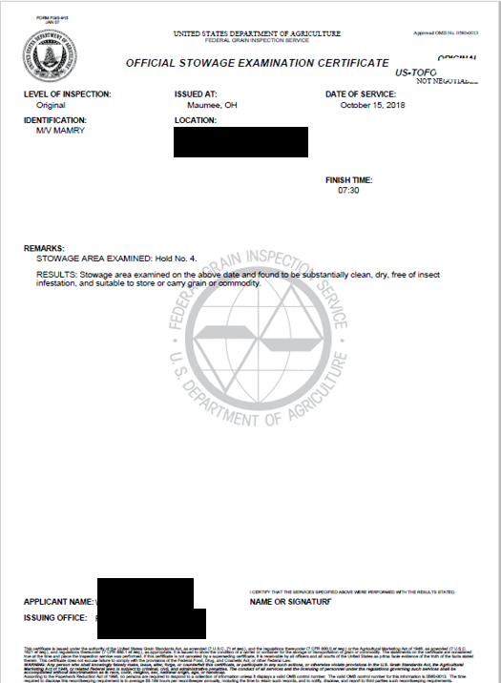
Form FGIS-915
Form FGIS-915 is the certificate used to officially report results to applicant
Official grain inspection certificates are legal documents that are admissible in court
Created from information contained in the Stowage Examination Worksheet (Form FGIS-939) and relevant paperwork
Accuracy and completeness is vital in all paperwork

Slide 22
Conclusion
This presentation introduced the documentation and instructions to be used when performing sampling functions
Practical hands-on instruction is required
Questions? See your trainer or FOM

Slide 23
References
Links to documents
    FGIS Form 907- Application for Service
    Grain Inspection Handbook, Book IV
    Program Directive 9180.48
    FGIS Form 991-Weighing Handbook, Pg. 2-32
    FGIS Form 992
    FGIS OnLine
        To create Online Ship Inspection Log
        To create Form 915 Official Certificate

