Slide 1
Specialty Crops Inspection Division

Slide 2
Programs and Services
SCI facilitates the efficient, fair marketing of America’s fresh, frozen, and processed fruits, vegetables, and other specialty crops by providing:
Grading, inspection, and certification services
Voluntary, audit-based services to verify good agricultural and manufacturing practices, HACCP, traceability, food defense, and export certification
U.S. grade standards and related guidance, and Commercial Item Descriptions for all commodities
Services are voluntary (except when mandated by Federal marketing orders, or school lunch and other feeding programs)
Services provided on a user-fee basis to anyone with a financial interest in product load
Notes:
Each year, SCI:
Inspects and certifies 60 billion of pounds of fresh and processed fruits, vegetables, and related products – including 2.2 billion pounds of specialty crops products valued at $2.9 billion for domestic feeding programs (e.g., school lunch) (2020)
Ensures the quality of 310 million military rations servings
Conducts more than 4,000 food safety verification audits
Issues more than 12,000 export certificates
Offers 300+ U.S. standards to facilitate marketing
Reviews 1,000 Child Nutrition Labels
Trains more than 2,000 Federal, State, and industry participants

Slide 3
Delivering to Stakeholders
Specialty Crops Industry
AMS CPP
FSIS FNS FSA FDA DoD NMFS
USDA and Federal Agencies
State Departments of Agriculture
AMS Managers and Employees
Specialty Crops Inspection Division
GFSI
Codex
UNECE
USAID
International Organizations
Notes:
Among our stakeholders are the USDA CPP and the U.S. military
Supporting USDA Commodity Procurement
Inspect USDA fruit and vegetable commodity purchases for Food Box Program, National School Lunch Program, and other USDA feeding programs
Write specifications for USDA fruit and vegetable purchases
Ensure U.S. origin of USDA purchases
Develop vendor requirements and review applications for Food Box Program and
USDA Pilot Project for Procurement of Unprocessed Fruits and Vegetables
Supporting Our Military
Inspect and certify food components
used in military food
Review food specifications for rations production and inspection
Inspect Operational Rations components, including meat, poultry, tuna, and vegetarian entrees; baked goods; peanut, fruit, and cheese spreads; and, beverage powders
Monitor suppliers’ sanitation and good manufacturing practices

Slide 4
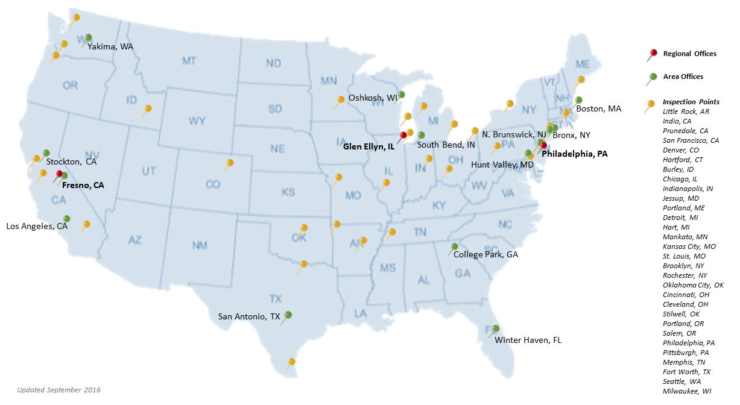
SCI Field Locations
Notes:
Workforce
650 full-time, part-time, permanent, intermittent and
mixed-tour employees
3,000 State cooperators
41 field locations
Headquarters in Washington, DC

Slide 5
Inspection Services
Inspect fresh and processed fruits, vegetables, nuts, and specialty crops products
Certify class, quality, quantity, and condition of product upon shipping or receipt in interstate commerce
Customers choose inspection type
  U.S. grade standards or contract terms
  Full inspection (quality and condition)
  Condition only
  Weight or count only
  Temperature only
  Custom certifications
We support an efficient marketing system that quickly moves wholesome, affordable agricultural products from farm to consumer
Notes:
For more information about SCI inspection services, please contact your local office or:
Inspection Operations
Specialty Crops Inspection Division
Telephone: 800-811-2373
Email: SCIinspectionoperations@usda.gov

Slide 6
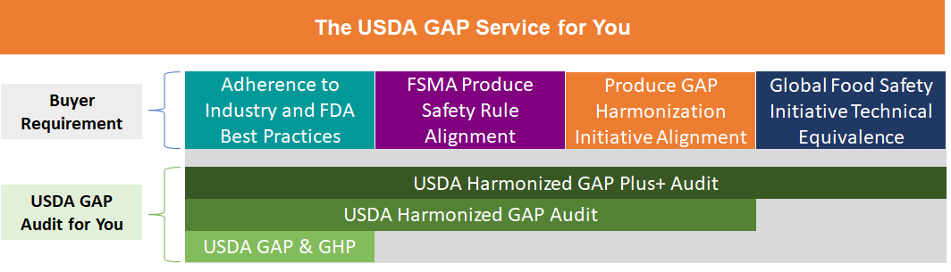
USDA GAP Audit Services
Meeting Buyers’ Needs
Notes:
Our audit services are:
Voluntary
Non-regulatory
Primarily used for market access (to meet buyer requirements)
100% user-fee funded ($115/hour, except HGAP Plus+, which includes a $250 certification fee)
Our audit programs are designed to ensure one USDA GAP audit can meet multiple buyer requirements

Slide 7

Audit Program Export Certifications
Pre-Export Check Program for almonds destined for the European Union
Aflatoxin control measures for peanuts destined for the European Union
European Union Certification Program for Sprouts and Seeds for Sprouts
Pistachio Export Aflatoxin Reporting (PEAR) Program

Slide 8
Standardization Programs
Develop and maintain 300+ U.S. standards for grades
  Standards define quality and condition factors for fresh and processed fruits, vegetables, nuts, and other specialty crop products
Develop and maintain 188 Commercial Item Descriptions (CID) for products in all commodity areas
  CIDs are official U.S. Government procurement documents that describe the most important characteristics of a commercial product
  Used by buyers to specify the product they want to purchase
Notes:
For more information on U.S. standards for grade and Commercial Item Descriptions, contact:
Standardization Branch
Specialty Crops Inspection Division
Telephone: (202) 540-361-1130

Slide 9
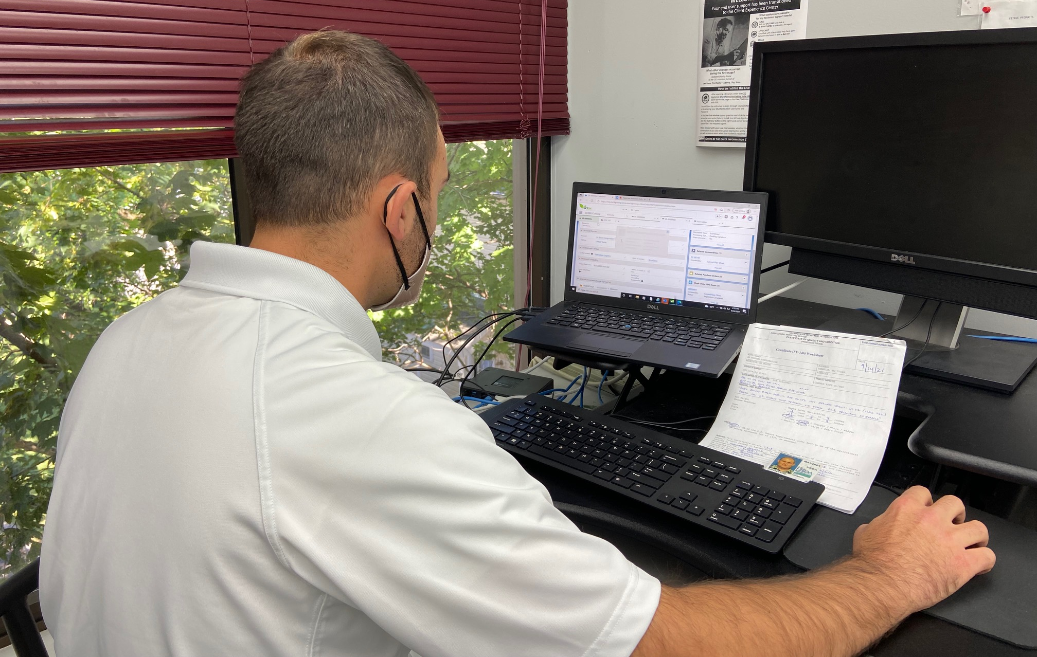

SCION
  Specialty Crops Integrated Operating Network
  New automated platform supporting USDA
  specialty crops grading, inspection, and audit
  business processes
  Allows applicants to request services, and get certificates, audit reports, and billing statements online
September 29, 2021 – SCI issued the first SCION-generated certificate!
Notes:
Replacing aging legacy systems (FEIRS and BIIS)
Being developed by Deloitte for USDA
Initial release expected in summer 2021

Slide 10
SCION Timeline
Release 1 | Release 2 | Release 3
September 27, 2021 | January 2022 | April 2022
Processed lot inspections Plant Surveys Audits (excluded GroupGAP) | In-plant inspections Shipping point inspections Operational Rations Citrus Quality Assurance Program Child Nutrition Labeling | Fresh products inspections Group audits Federal/State integration
Notes:
Replacing aging legacy systems (FEIRS and BIIS)
Being developed by Deloitte for USDA
Initial release expected in summer 2021

Slide 11
Specialty Crops Inspection Division

