Slide 1

Federal Crop Insurance
FEDERAL CROP INSURANCE
Whole Farm Revenue Protection
Tara Ponds
Specialty Crops Coordinator
[DATE]

Slide 2

Whole Farm Revenue Protection
Whole-Farm Revenue Protection (WFRP)
The Agricultural Act of 2014 (Farm Bill) instructed RMA to develop a whole-farm diversified risk management plan of insurance
Since 2015, WFRP has provided coverage for all revenue produced on a farm
Includes farms with specialty or organic commodities (crops and livestock), or those marketing to local, regional, farm-identity preserved, specialty, or direct markets
The first crop insurance product available nationwide, in every county in the United States
Currently there is more than $2.1 billion in WFRP liabilities nationwide, with 1,934 WFRP policies sold (as of 10/26/2021)

Slide 3
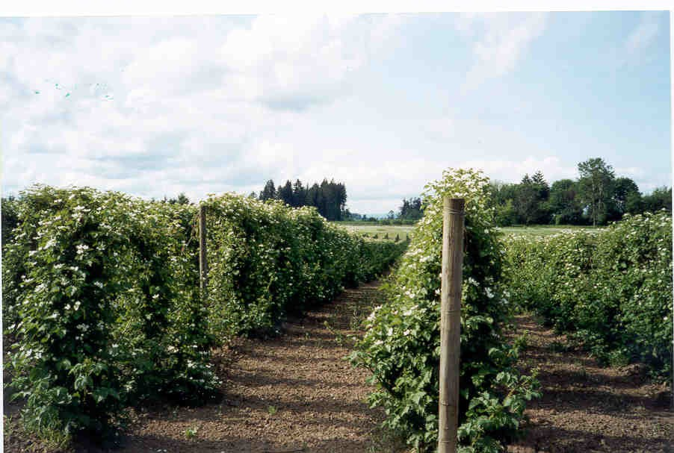
What does WFRP cover?
Revenue from all commodities produced on the farm:
  Including animals and animal products
  Commodities purchased for resale (up to 50% of total)
  Excluding timber, forest, forest products, and animals for sport, show or pets
Replant costs (with approval)

Slide 4
How is the amount of insured revenue determined
How is the amount of insured revenue determined?
WFRP insured revenue is the lower of:
  Your current year’s expected revenue (determined by your farm plan) at the selected coverage level, or
  Your historic revenue adjusted for growth at the selected coverage level
    Automatic indexing process accounts for farm growth historically
    Expanding operations provision allows for up to 35% growth over historic average with insurance company approval

Slide 5
Does diversification on farm matter for WFRP? Yes!
The number of commodities produced are counted toward the diversification requirement within WFRP
  The WFRP commodity count is a calculation rather than simply a count of commodities produced.
  Each commodity must provide a calculated percentage of the expected farm revenue to be counted
  Commodities providing small amounts of revenue may be grouped to meet the qualification

Slide 6

Direct Marketed Commodities
Allows direct market producers to report two or more direct marketed commodities using one combined commodity code
  Must report at least two commodities sold through direct marketing under the combined commodity code
  Commodities reported as combined direct marketing are not required to have separate expected values
    Expected Revenue based on total revenue from the combined commodities and total acres planted to the combined commodities

Slide 7

Coverage Levels
Coverage levels range from 50-85%
  5% increments
  Diversification of 3 commodities (commodity count) required for 80% and 85%
  No catastrophic level of WFRP available

Slide 8
WFRP Premium Subsidy
Basic Subsidy for Commodity Count = 1
Whole Farm Subsidy for Commodity Count of 2 or more
WFRP Subsidy: Percentage of Total Premium Paid by Government
Coverage Level | 50% | 55% | 60% | 65% | 70% | 75% | 80% | 85%
Basic Subsidy-Qualifying Commodity Count: 1 | 67% | 64% | 64% | 59% | 59% | 55% | N/A | N/A
Whole-Farm Subsidy-Qualifying Commodity Count: 2 | 80% | 80% | 80% | 80% | 80% | 80% | N/A | N/A
Whole-Farm Subsidy-Qualifying Commodity Count: 3 or more | 80% | 80% | 80% | 80% | 80% | 80% | 71% | 56%

Slide 9
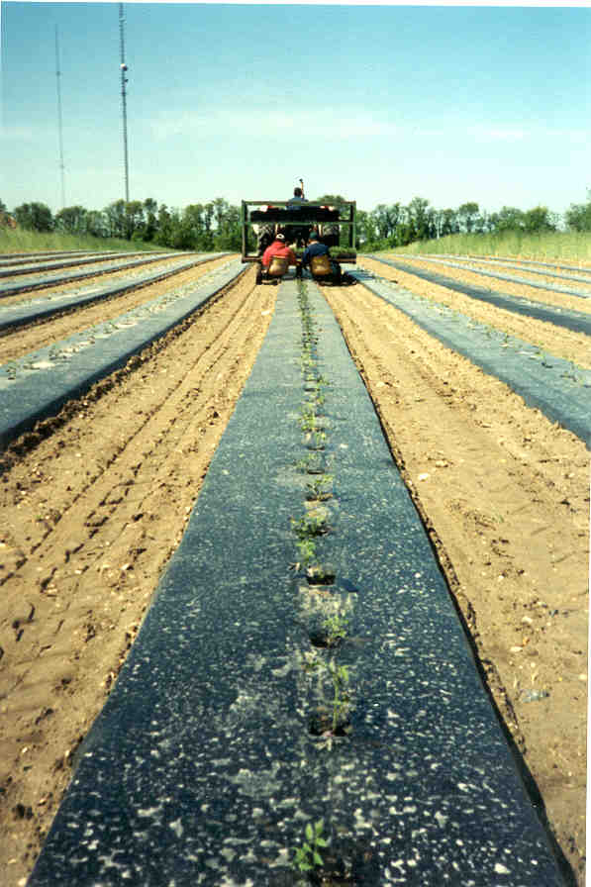
Eligibility
  Eligibility for WFRP
    Commodities insurable with other revenue coverage must have 2 commodities
    Potato farms must have 2 commodities

Slide 10
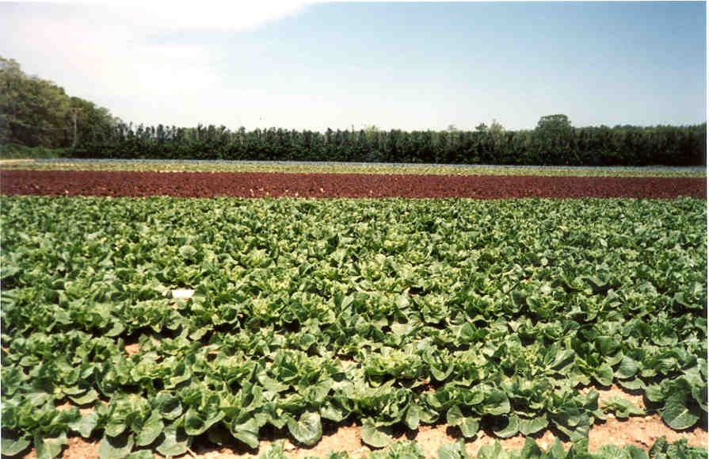
What causes a loss payment under WFRP?
Natural causes of loss and decline in market price during the insurance period
When revenue-to-count for the insurance year is lower than insured revenue, a loss payment will be paid
Taxes must be filed for the insurance year before any claim can be made (2021 insurance year requires 2021 farm taxes to be filed)

Slide 11
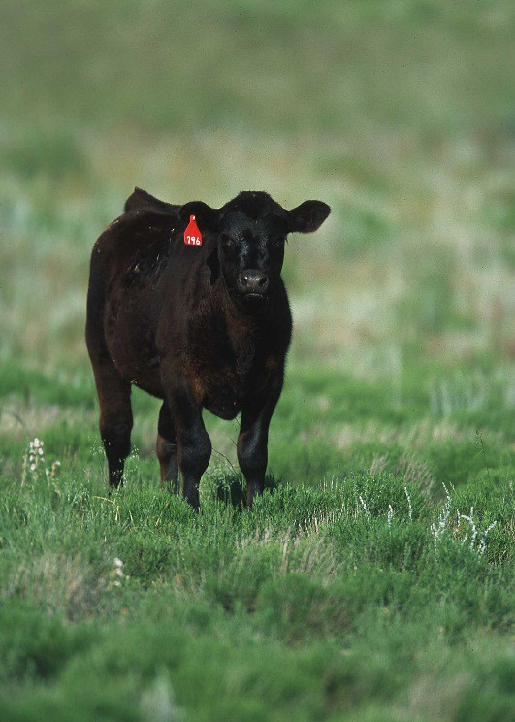
What will my agent need from producer?
Five years of farm tax forms
  For 2021, requires tax forms from 2015-2019
    Exceptions are made for Beginning Farmers and Ranchers, Qualifying persons not required to file US Tax Return (Tribal
Entities), and producers that were physically unable to farm one year.
Information about what you plan to produce on the farm during the insured year
  Used to complete the Intended Farm Operation Report
Other information as applicable
Such as supporting records, your organic certification, inventory or accounts receivable information…

Slide 12
How are tax returns used for WFRP?
Determine amount of revenue from insurable items to calculate “allowable revenue” for previous years.
  These totals are entered on the Whole-Farm History Report
  The Federal farm income tax forms are your “revenue history” and act similar to an Actual Production History (APH) used for other Federal crop insurance

Slide 13
USDA Fruit & Vegetable Industry Advisory Committee Draft Recommendations
Enhance education efforts for both producers and crop insurance agents and simplify the reporting requirements necessary for participation.
  RMA education plans
Evaluate the $8,500,000 revenue limit and adjust (annually) to correspond with current inflation rates.
  WFRP covers up to $8.5 million – insured farm revenue multiplied by coverage level selected
  Recommended revenue limit amount?
Develop a product – similar to WFRP – for beginning farmers that do not have the five-year operational experience.
  Existing provisions for beginning farmers

