Slide 1

My Plate Resources
MyPlate Resources:
Interactive tools to help Americans make healthy eating choices
USDA Food and Nutrition Service
Center for Nutrition Policy & Promotion
Office of Nutrition Marketing & Communication

Slide 2

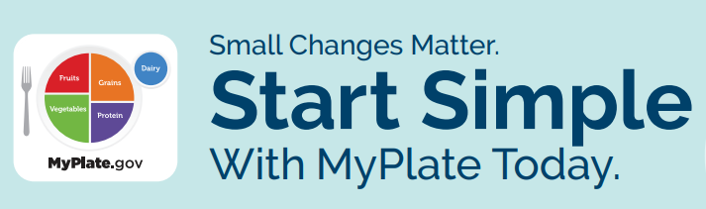
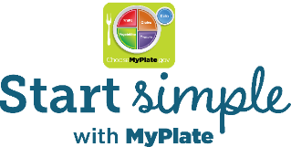
MyPlate Consumer Messaging
2020-2025 DGA call to action (“what”)
MyPlate call to action (“how”)
Make every bite count with the Dietary Guidelines
Start Simple with MyPlate
Provides inspiration and simple ideas people can incorporate into their busy lives to help them improve their health and well-being over time
Encourages people to choose foods, beverages, meals that are full of important nutrients

Slide 3
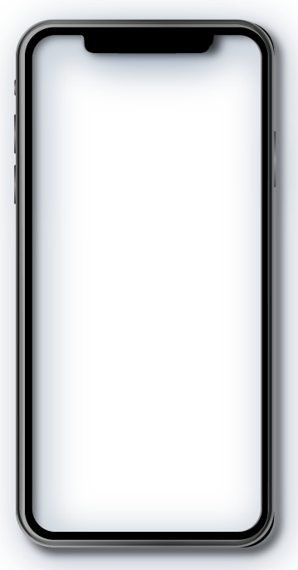
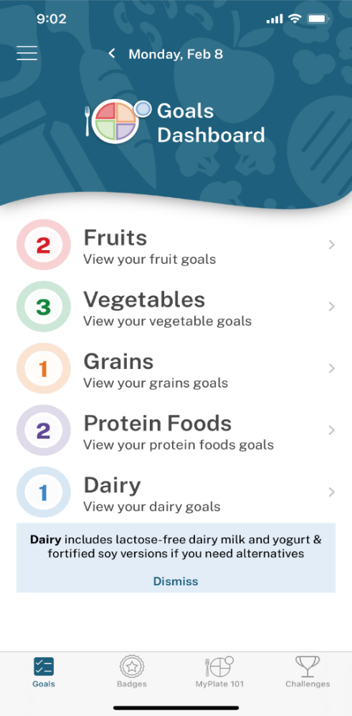
Start Simple with MyPlate App
A simple, goal-setting tool for consumers, to meet them where they are
Pick Goals
Highly customizable: choose daily food group goals that work for you
Samples: Snack on vegetables or Start your day with dairy
Each goal has 3 corresponding tips with ideas for implementing the goal
See Real-Time Progress
View daily progress on the Goals Dashboard as food group goals are completed
Earn Badges and Celebrate Success
Earn a variety of badges as goals are completed
Share badges on social media
Take it to the Next Level
Join challenges to stay motivated and try new goals
Features
Create an e-Auth account
Save your favorite food group tips
Sync MyPlate Quiz results to set goals in the app
New

Slide 4
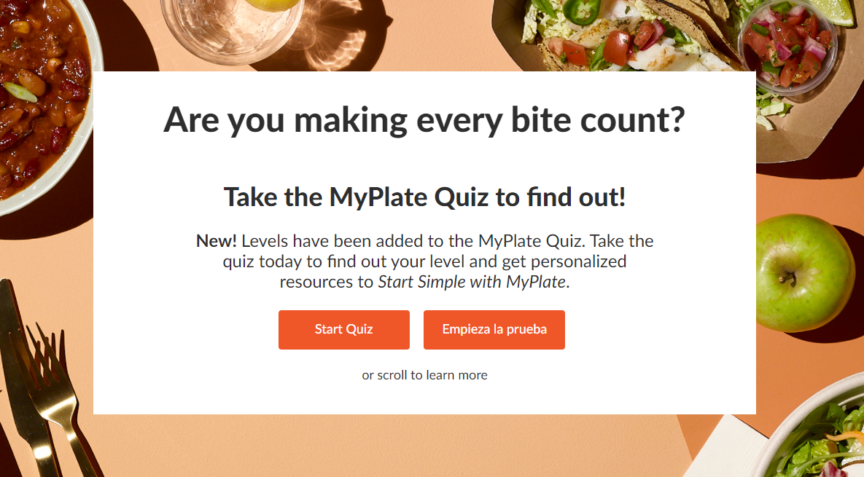
MyPlate Quiz
A fun, interactive tool available in English and Spanish that consumers can use to assess their eating behaviors
Users answer a series of 20 questions about the MyPlate food groups and their healthy eating interests
Consumers receive a snapshot of how they're doing on the MyPlate food groups and get personalized resources based on their quiz results
Download a PDF of the results to track progress over time

Slide 5
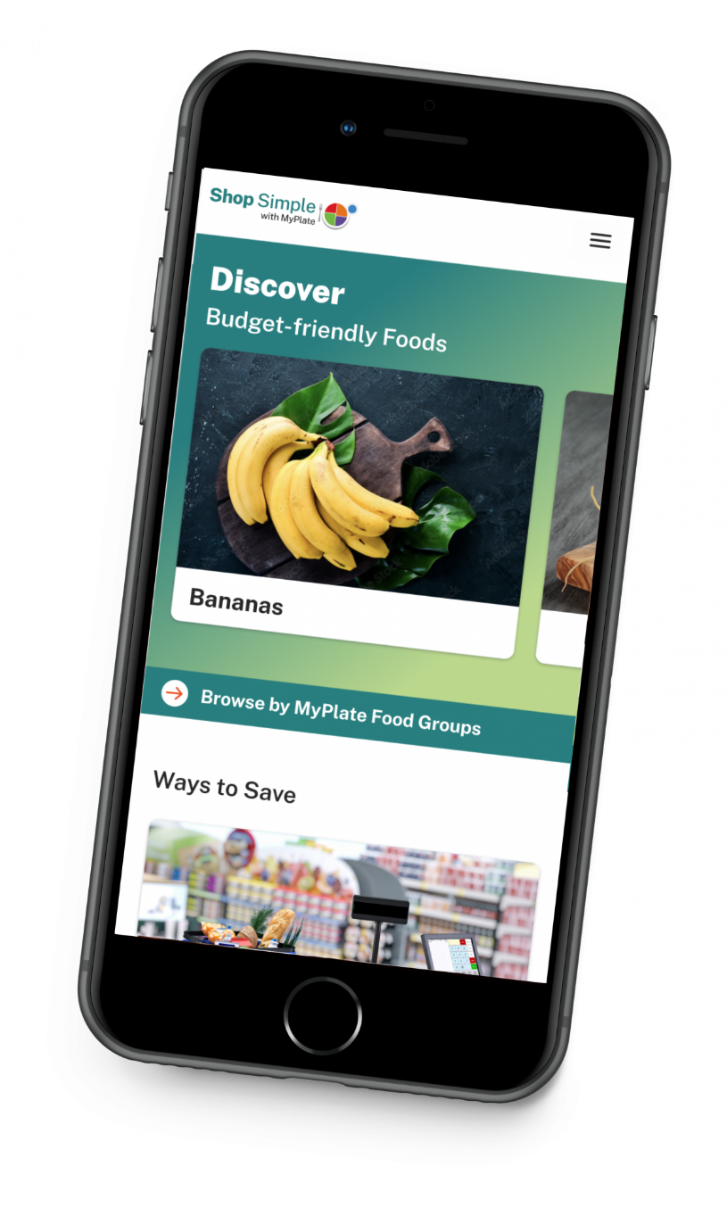
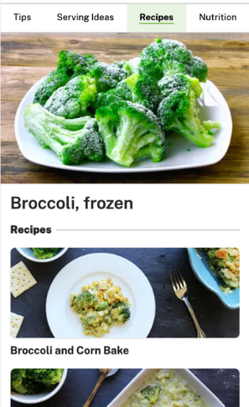
Shop Simple with MyPlate Tool
Shop Simple with MyPlate is a web app to help Americans save money while shopping for healthy food choices
SNAP Savings: Enter your zip code to find cost-saving opportunities in your local area, including stores that accept SNAP EBT, rewards programs, and farmers markets.
Budget-friendly foods: View suggestions from each food group. Get purchasing and storage tips, serving ideas, recipes, and nutrition information.

Slide 6
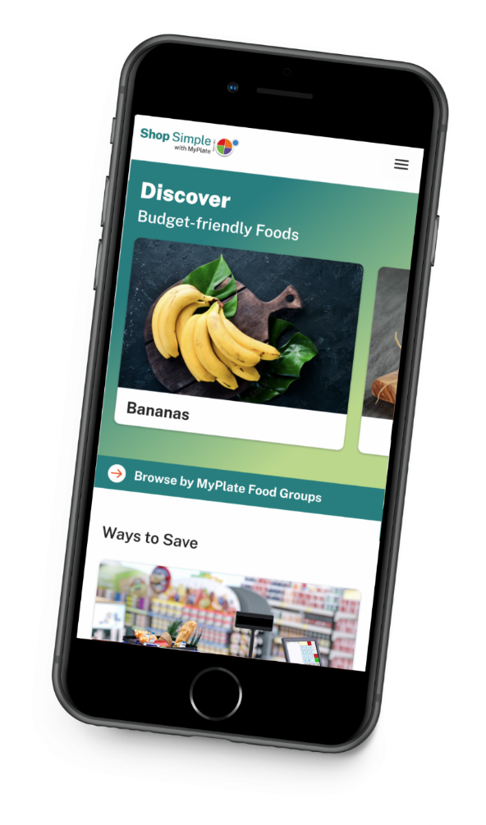
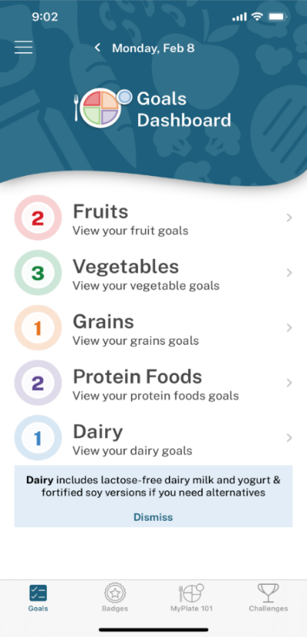
Usage
Start Simple with MyPlate App
Since launch, December 29, 2020:
203,556 total app installations
MyPlate Quiz
Since launch, December 29, 2020:
The quiz has been taken 840,000 times
Shop Simple with MyPlate Tool
Since launch, October 1, 2021:
121,359 pageviews
9,716 total users

