Slide 1
Country of Origin Labeling
Retailer Requirements and Surveillance Activities
for Food Marketing Institute Members
September 30, 2015

Slide 2
Country of Origin Labeling (COOL) is a labeling law that requires retailers, such as full-line grocery stores, supermarkets, and club warehouse stores to notify their customers with information regarding the source of certain foods.
Part 1 – Retailer Requirements
Part 2 – Surveillance Activities

Slide 3
Part 1 – Retailer Requirements
          Definition of “Retailer”
          Covered Commodities
          Determining Origin
          Labeling Flexibilities
          Recordkeeping

Slide 4
Retailer
Retailer means any person subject to be licensed as a retailer under the Perishable Agricultural Commodities Act (PACA) of 1930.
  The criteria for a retailer PACA license is annual purchases of at least $230,000 for fruits and vegetables.
  The corporate headquarters typically holds the PACA license for all of their stores and may have more than one license.

Slide 5
Retailer
  Remotely Purchased Products, such as online sales that meet the PACA license criteria, are also subject to COOL requirements. (7 CFR § 65.300 Country of Origin notification):
  “For sales of a covered commodity in which the customer purchases a covered commodity prior to having an opportunity to observe the final package (e.g., internet sales, home delivery sales, etc.), the retailer may provide the country of origin notification either on the sales vehicle or at the time the product is delivered to the consumer.”

Slide 6
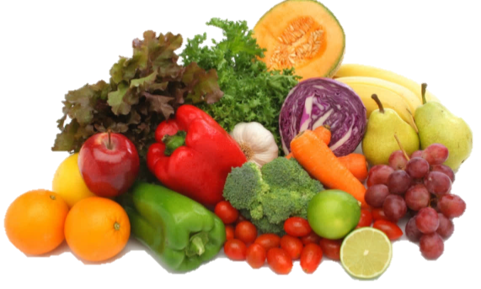
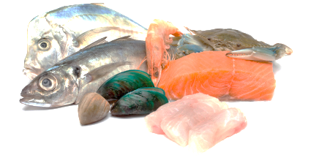
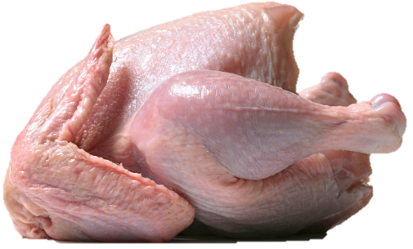
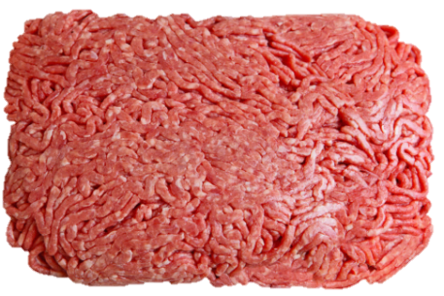

Covered Commodity
Fruits and Vegetables
Fish and Shellfish
Muscle Cut and Ground Meats
  Beef, including Veal
  Pork
  Lamb
  Goat
  Chicken
Peanuts, Pecans, Macadamia Nuts
Ginseng

Slide 7
Determining Origin
Retailers convey information as provided by their suppliers to consumers. Origin declarations must be accurate and specific to the contents of the package or display.
Covered Commodity | Origin Declaration
Fruits and Vegetables, Nuts, and Ginseng | Country(ies) where grown (grown also means “harvested”). May be commingled. State and regional names and state abbreviations accepted in lieu of country.
Fish and Shellfish | Country(ies) where harvested or substantially transformed, (as determined by Customs and Border Protection upon import). May be commingled. Must also include Method of Production – Farm Raised or Wild Caught. Farm Raised - fish or shellfish that have been harvested in controlled environments. Wild Caught - caught, taken, or harvested from non-controlled waters or beds.
Meat Muscle Cuts | For U.S. harvest, must include animal production steps, born, raised, and harvested. Cannot be commingled. Imported muscle cuts only need to list country of origin (“Product of Australia”).
Ground Meats | Must list all countries of origin that may be reasonably contained therein. Origin must be within the processor’s inventory in the past 60 days. May be commingled.

Slide 8
Labeling Flexibilities
General - Labeling of covered commodities offered for sale whether individually, in a bulk bin, carton, crate, barrel, cluster, or consumer package must contain country of origin.
Exclusions - A covered commodity is excluded from this subpart if it is an ingredient in a processed food item.
Labels - Declarations can either be in the form of a placard, sign, label, sticker, band, twist tie, pin tag, or other format that allows consumers to identify the country of origin, or may be in the form of a check box.

Slide 9
Recordkeeping
Retailers’ records:
Any records used in the normal course of business that verify a country of origin claim.
May be maintained in any location and in any format.
Are used to identify the covered commodity, the retailer’s immediate previous supplier, and the country of origin (and method of production in the case of fish and shellfish).
Must be maintained for a period of one year from the date the origin declaration is made at retail.

Slide 10
Recordkeeping
In general, retailers are to convey the origin information provided by their suppliers.
Records must either be maintained at the retail facility or at another location for as long as the product is on hand and provided to any duly authorized representative of USDA.

Slide 11
Recordkeeping
For pre-labeled products (consumer-ready packages and master containers), the label itself is sufficient information on which the retailer may rely to establish the product's origin, and no additional records documenting origin information are necessary.
For records that identify the covered commodity, the retail supplier, and products that are not pre-labeled, the country of origin information must be maintained for a period of 1 year from the date the origin declaration is made at retail.

Slide 12
Part 2 – Surveillance Activities
          Enforcement
          Types of Retail Reviews
          Retail Review Expectations
          Compliance Rating Criteria
          Responding to Notices of Non-Compliance
          FY 2016

Slide 13
Enforcement
The COOL Division partners with state agencies to assist with administration of the program.
State cooperators are trained and certified by COOL Specialists to conduct retail reviews in store locations assigned by the COOL Division.
Assigned retail locations to state cooperators are dependent on the previous year’s store compliance rating, responsiveness, and overall trends.
COOL Division Auditors audit individual products through the supply chain to verify accuracy of COOL claims.
Notes:
,

Slide 14
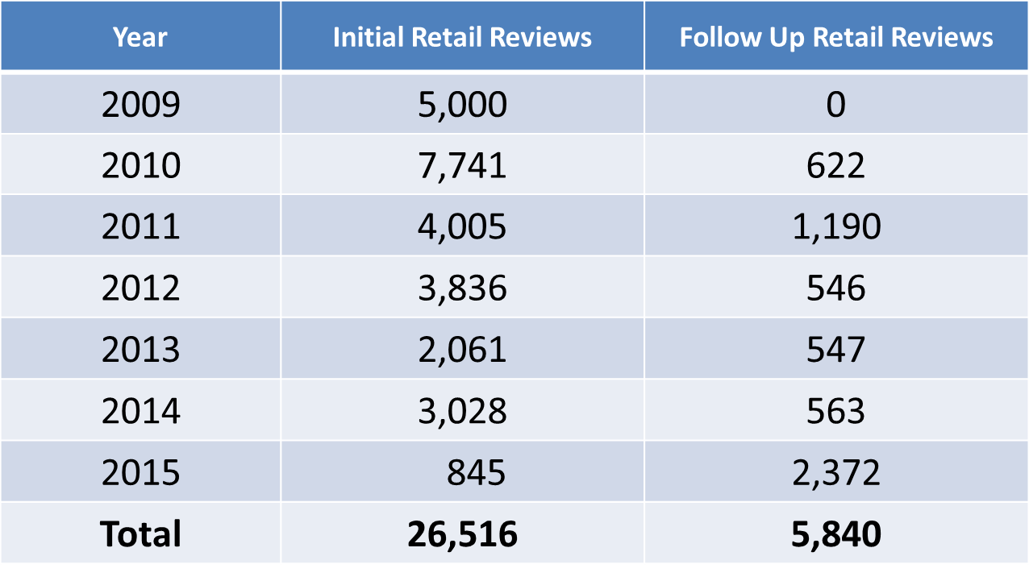
Retail Review Assignment History

Slide 15
Types of Retail Reviews
Initial Reviews
    Conducted in stores once every 5 years.
    All covered commodities reviewed for labeling compliance.
    Recordkeeping compliance is assessed by interview questions.
Follow Up Reviews
  Past critical compliance weakness, non-responsive or inadequate corrective actions, and preventative measures.
  All covered commodities reviewed for labeling compliance.
  Photographs are taken of all non-complying items.
  Recordkeeping compliance is assessed through providing records within 5 days of the Follow Up review.

Slide 16
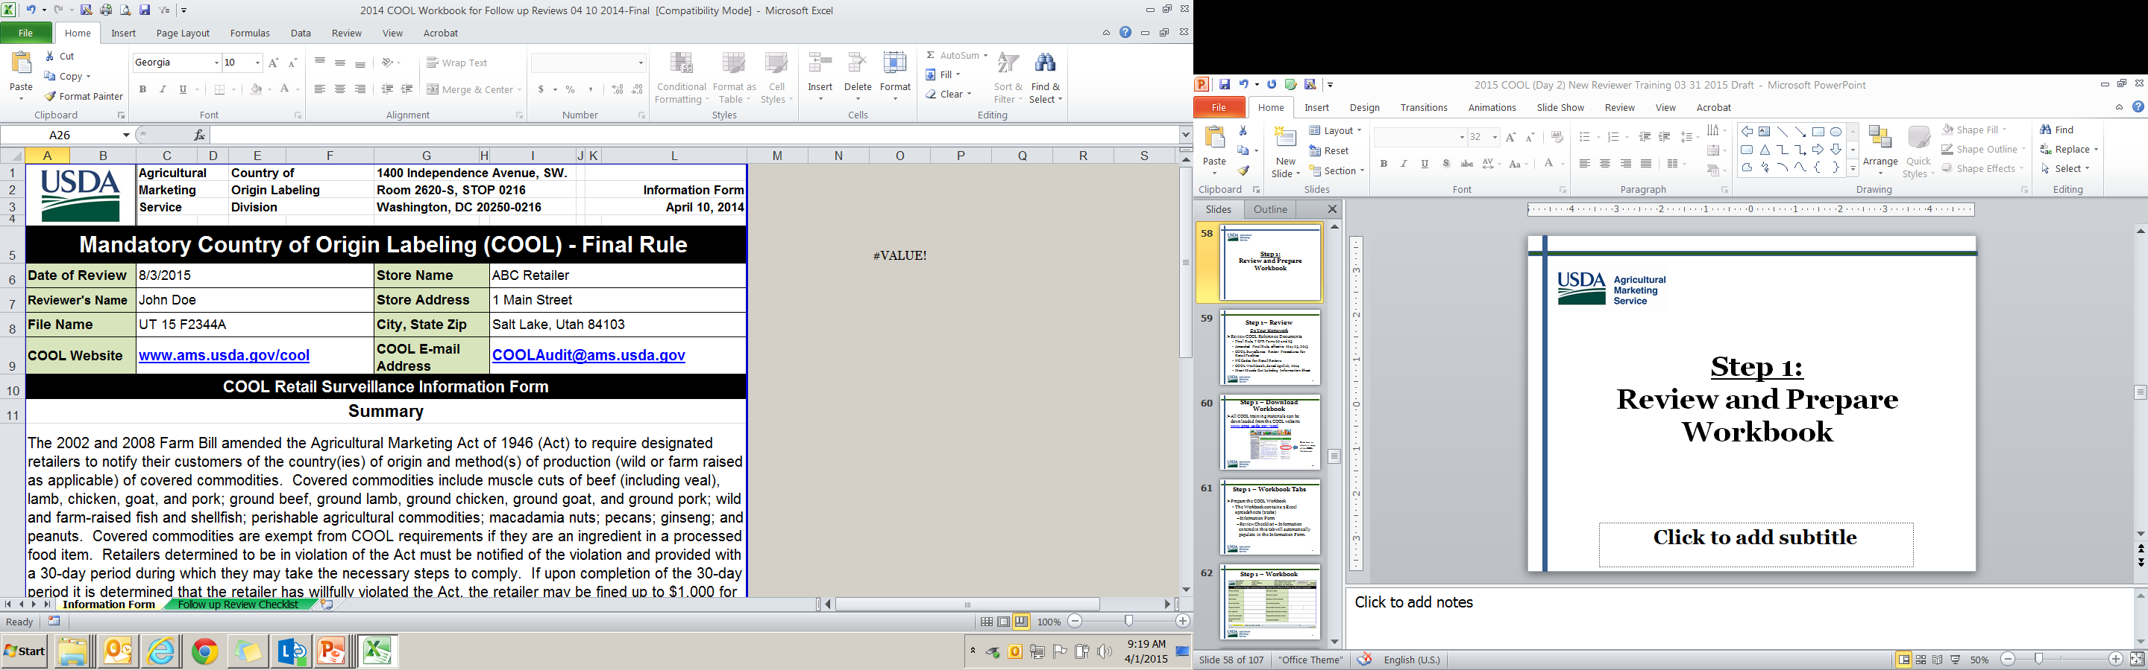
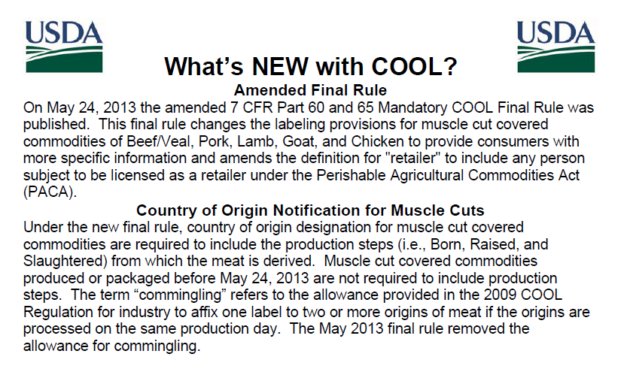
The 4-Step Retail Review
(1) Opening Meeting:
    Reviewers will conduct a short meeting with the responsible authority.
    Explain the scope and objective of the review.
    Provide a short summary of what they will be looking for by providing a copy of the Information Sheet.
    Store representatives are encouraged to accompany the Reviewer during the review.

Slide 17
The 4-Step Retail Review
(2) Conducting the Review:
  The Reviewer will review all covered commodities:
        Produce Department (fresh and frozen fruits and vegetables; ginseng)
        Baking Aisle (nuts: raw peanuts, pecans, macadamia nuts)
        Meat Department (fresh and frozen beef, veal, pork, lamb, goat, chicken)
        Seafood Department (fresh and frozen fish and shellfish)
        Full-service counters
        Frozen items display cases
        Self-service areas, sale counters, and promotional displays

Slide 18
The 4-Step Retail Review
(3) Recordkeeping:
During initial reviews, Reviewers will interview the store representative to assess recordkeeping compliance.
Q1: What types of records used in the normal course of business are received from suppliers that you rely on to create your own labels, such as signs, placards, and scale printers?
Q2: Where are records maintained?
Q3: How long are records maintained?
Q4: As the responsible store authority, please briefly explain your knowledge of COOL requirements and your systems to ensure compliance.
Q5: Would you be interested in receiving additional outreach materials and guidance from USDA’s COOL program to assist your staff and consumers?

Slide 19
The 4-Step Retail Review
(3) Recordkeeping:
During follow up reviews, Reviewers will request records for up to 5 covered commodities to assess recordkeeping compliance.
      For Pre-labeled items, retailers must provide:
          A record that verifies the retailer’s immediate previous supplier (name, city, and state).
          The retailer’s immediate previous supplier is the company that delivered the covered commodity to the store.
          The record is not required to have the country of origin or method of production because that is printed on the pre-labeled item.

Slide 20
The 4-Step Retail Review
(3) Recordkeeping:
During follow up reviews, Reviewers will request records for up to 5 covered commodities from various categories to assess recordkeeping compliance.
      For items that are NOT Pre-labeled, retailer must provide:
          A record that verifies the country of origin, method of production (if applicable), AND retailer’s immediate previous supplier (name, city, and state).
          Retailers may provide multiple records to verify country of origin, method of production, and immediate previous supplier.

Slide 21
The 4-Step Retail Review
(3) Recordkeeping:
All records must be submitted directly to the Reviewer.
(Do not submit records to USDA.)
Information obtained for recordkeeping items will be used to initiate Supplier Traceback Audits which verify accuracy of COOL through the chain of commerce.

Slide 22
The 4-Step Retail Review
(4) Closing Meeting:
The Reviewer will provide the Store Representative a copy of the completed Checklist.
The Reviewer will discuss the results of the review and any findings identified.
Inform the Responsible Authority that Findings are not official until reviewed by USDA.

Slide 23
The 4-Step Retail Review
(4) Closing Meeting:
If the store received 4 or more non-compliance codes, they will receive official notification from USDA requiring a response with corrective actions and preventative measures.
The Reviewer will verify name of Responsible Authority, email address, mailing address, and phone number.

Slide 24
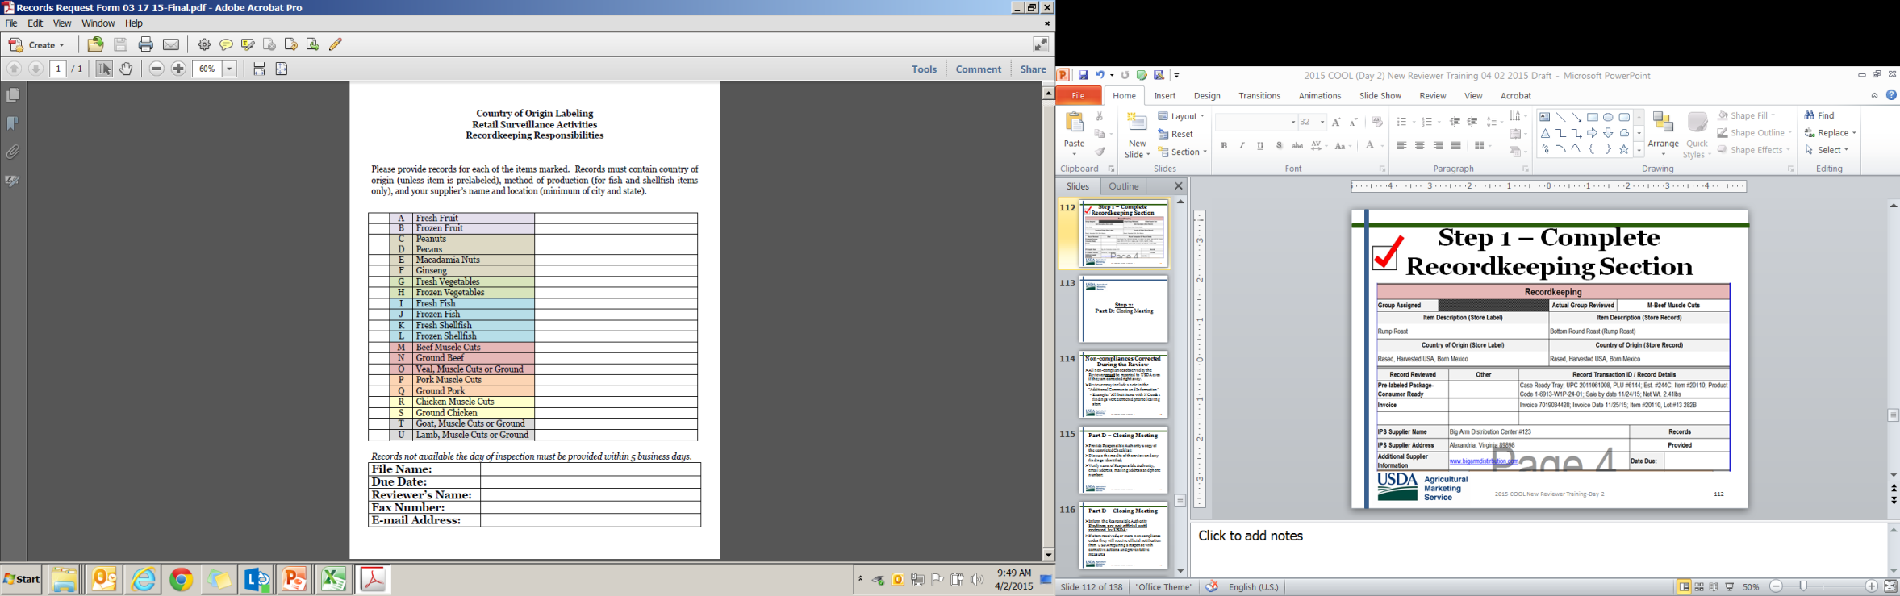
The 4-Step Retail Review
(4) Closing Meeting:
The Reviewer will provide their contact information should there be questions after the review.
The Reviewer will provide a Records Request Form in case of pending records requests.

Slide 25
Compliance
Retail Review Compliance Rating Scale - The COOL Division notifies each retail store in writing where there are findings of non-compliance.
The COOL Division uses a compliance rating scale as a guideline for identifying the severity of a retailer’s compliance system weaknesses. The following rating scale assesses COOL compliance for retail stores:
a) Adequate: NC<4 AND NC as Percent of Commodity Count <5%
b) Compliance Deficiency: NC ≥4 or NC as Percent of Commodity Count ≥5%
c) Critical Weakness: NC>14 AND NC as Percent of Commodity Count ≥5
Non-compliance notices are not sent to retailers with an Adequate compliance rating.
Non-compliance notices are sent to store locations (by email or by overnight carrier) to address Compliance Deficiencies and Critical Weaknesses.

Slide 26
Compliance
Responding to Non-Compliance Notices
    Retailers are required to correct non-compliances within 30 days.
    Retailers must submit a written response to the non-compliance notice describing corrective actions and preventative measures for all findings.
    Responses to non-compliance notices must be submitted to USDA within 30 days of receipt of the notice.

Slide 27
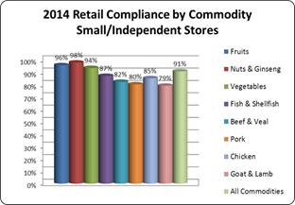
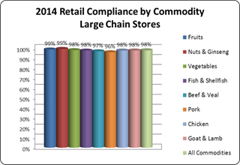
2014 Retail Compliance
Table 1
Table 2
Table 1: During FY2014, COOL retail surveillance activities were targeted in small and independently owned retail stores, a segment of the industry with weaker compliance trends.
Table 2: Large chain stores have higher compliance in comparison to small and independently owned retailers.

Slide 28
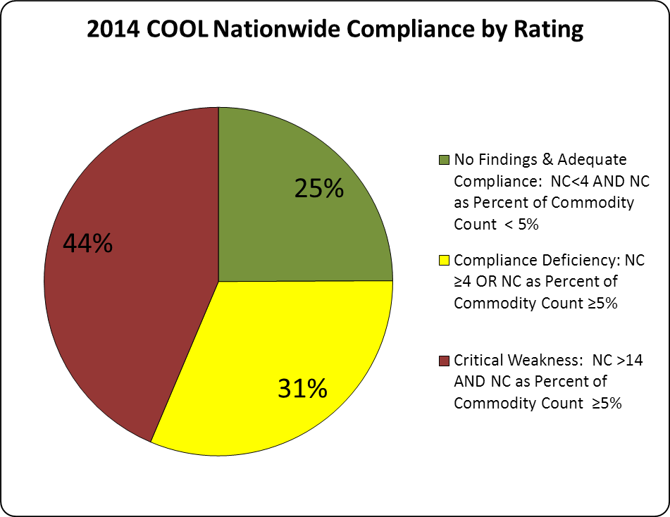
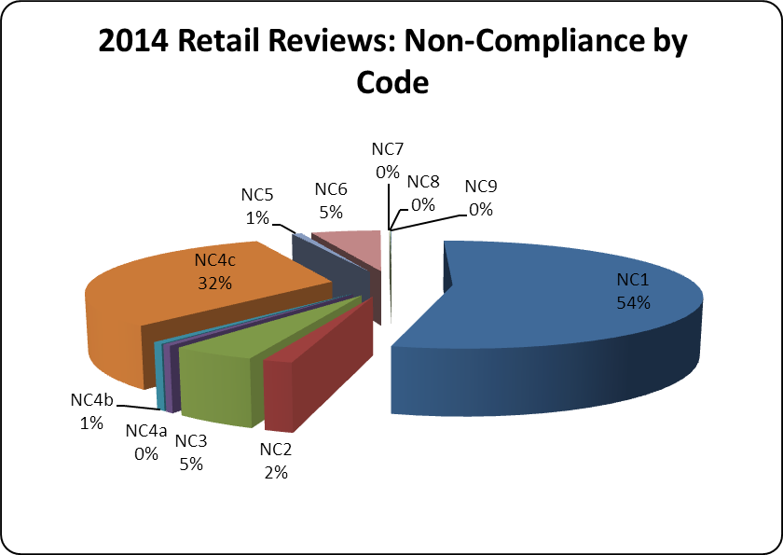
2014 Retail Compliance
Table 3
Table 4
Table 3: Due to the high number of retailers with a critical weakness compliance rating in 2014, a large number of follow up reviews were conducted at these stores in 2015.
Table 4: Over half of 2014 non-compliances was due to no COOL at the point of sale. The second most prevalent finding, 32%, was due to animal production step labeling issues on meat muscle cuts.

Slide 29
FY 2016 Enforcement Activities
Continue to enforce mandatory labeling requirements on all covered commodities.
Initial and Follow Up retail reviews in traditional retail stores, (after the holidays), and after state cooperators are trained and certified.
Conduct outreach for non-traditional retailers (PACA-licensed online sales & convenience stores) and consumers.
Implement enforcement strategy for remote retailers and convenience stores subject to PACA licensing.
Possible rulemaking activities should Congress change the statute for meat covered commodities.

Slide 30
Resources
Email for General Questions: cool@ams.usda.gov
Email for Retail Review Questions: coolaudit@ams.usda.gov
Phone: (202) 720-4486 Fax: (202) 354-5062
Website: http://www.ams.usda.gov/rules-regulations/cool
+++++++++++++++++++++++++++++++++++++++++++++
Julie Henderson, Director, COOL Division
Julie.Henderson@ams.usda.gov
Ken Becker, Agricultural Marketing Specialist
Kenneth.Becker@ams.usda.gov

