Slide 1
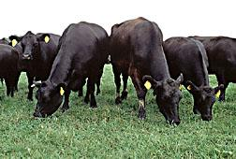

Beef 101
Bucky Gwartney, Ph.D.
International Marketing Specialist, AMS
Rod Bowling, Ph.D.
Marketing Specialist, AMS

Slide 2
This presentation is a real world example of how cattle are handled in a modern beef packing plant
We believe it is our ethical obligation to honor and respect livestock in the most humane way
To provide transparency, we are shining a light on the complete process

Slide 3
Beef Production Life Cycle
Beef product changes hands 7 - 8 times prior to consumption
Multiple nutritional mgmt. possibilities create flexibility
Cow gathers grass and feed their rumen fermentation chamber
Greenhouse-gas directly related to livestock production in the U.S. Only account for 2.6% of the total (U.N./FAO 26% was in error)
Rumen bacteria digest everything from low quality forage to corn/soy rations
Typical beef life cycle: 2 mo breeding, 9 mo gestation, 18-22 mo slaughter = 3 yrs
Notes:
Second bullet: could comment saying “Unlike beef, pork and poultry have a single nutritional source…”

Slide 4
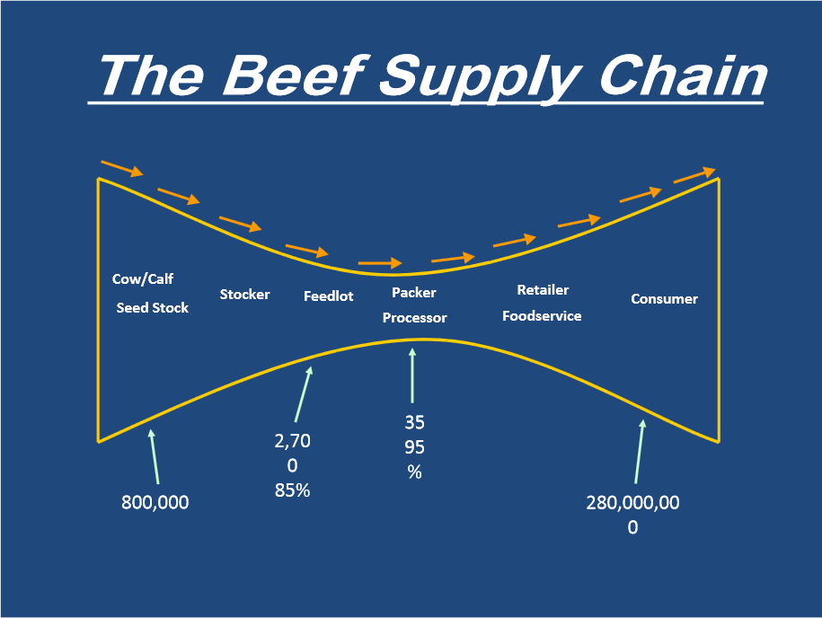

Slide 5
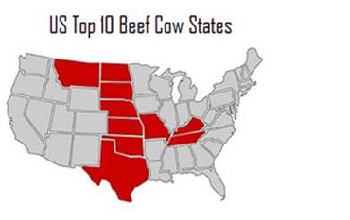
Cow/Calf Section

Slide 6
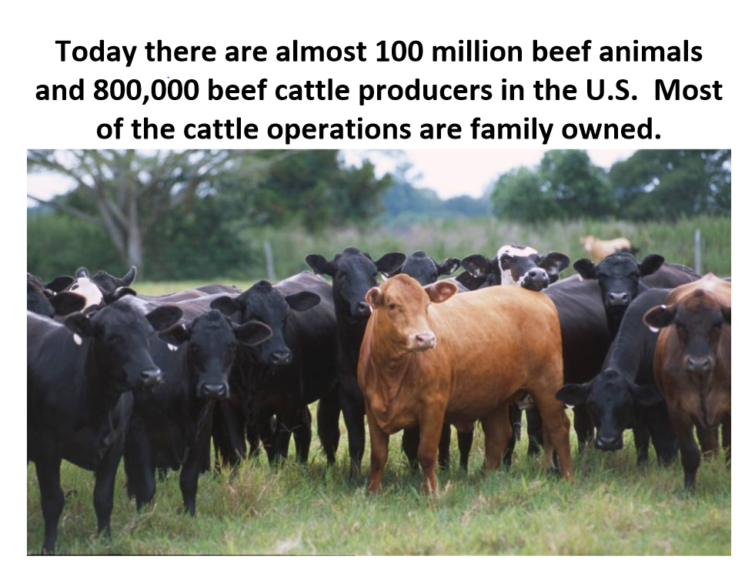

Slide 7
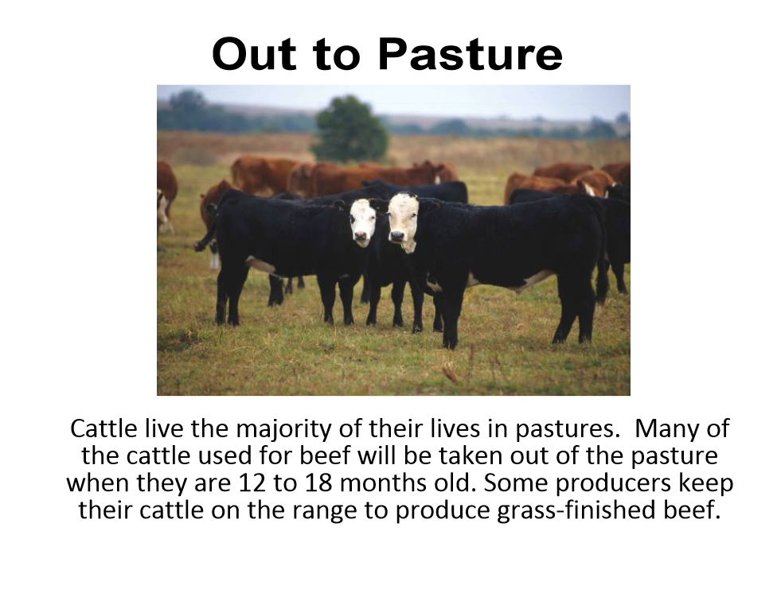

Slide 8
Cattle Feeding History
Prior to WWII, all cattle were grass-fed, beef supply was seasonal (available october – march)
Farming used horses until WWII, then tractors were required to farm the land and produce crops
Soon, farmers produced too much corn (creating a corn surplus) leading to the creation of cattle feeding
Traders and consumers realized that “corn-fed” beef had better flavor, color, and tenderness. USDA beef grading followed quickly.

Slide 9
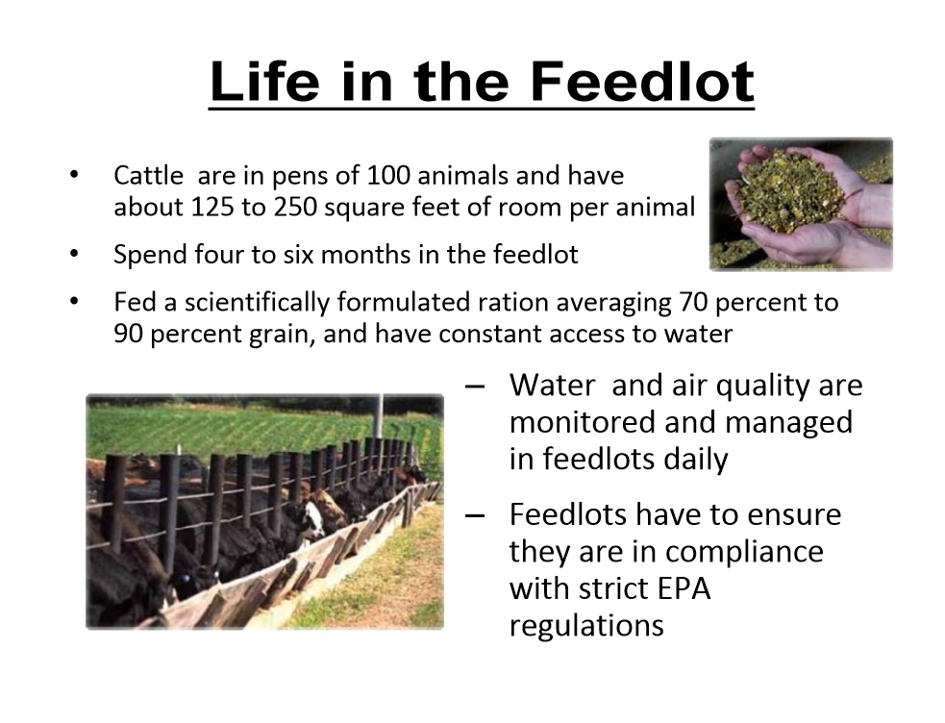

Slide 10
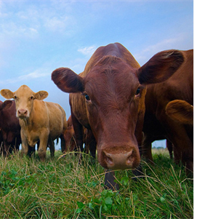
Why Do We Feed Cattle?
Cost efficiencies!
Notes:
Bucky’s fixing

Slide 11
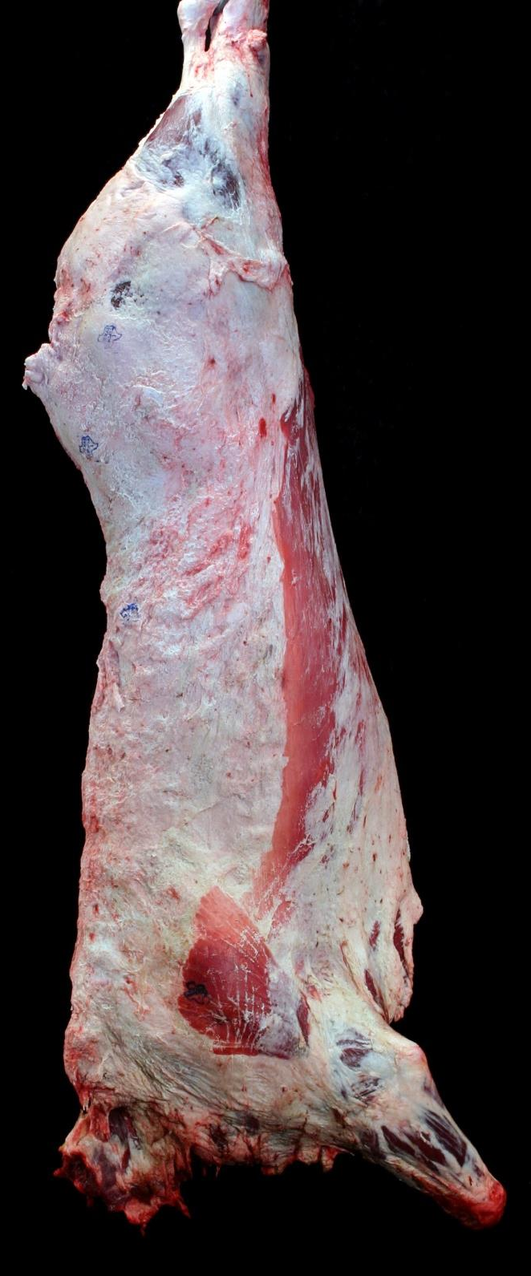
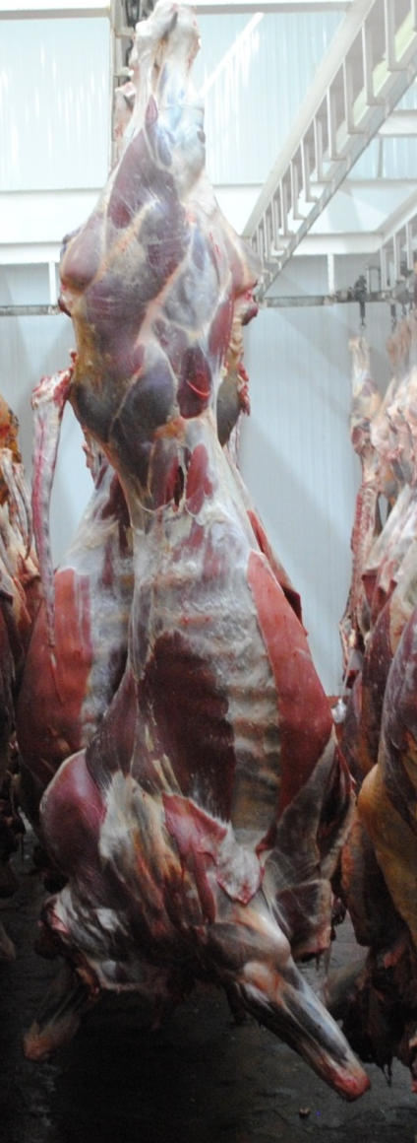
A Tale of 2 Production Systems
Right:
U.S. steer carcass with 0.4 inches of rib fat at 18 months old, less than 25% Bos indicus.
Left:
Bull carcass in Latin America with little fat at 30 months old, 100% Bos indicus.
Photos: D.B. Griffin and A.D. Herring

Slide 12
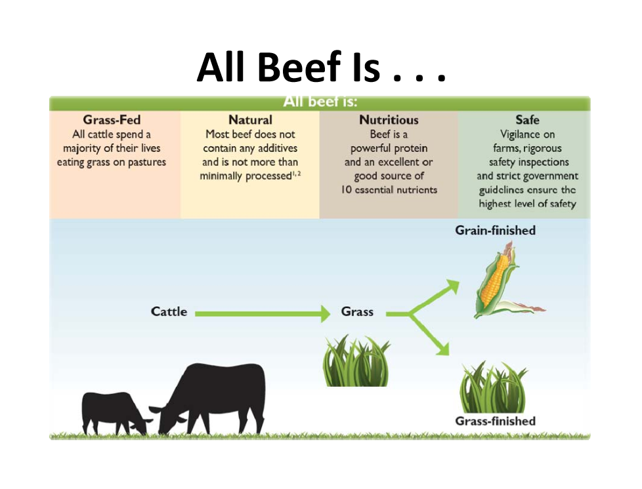

Slide 13
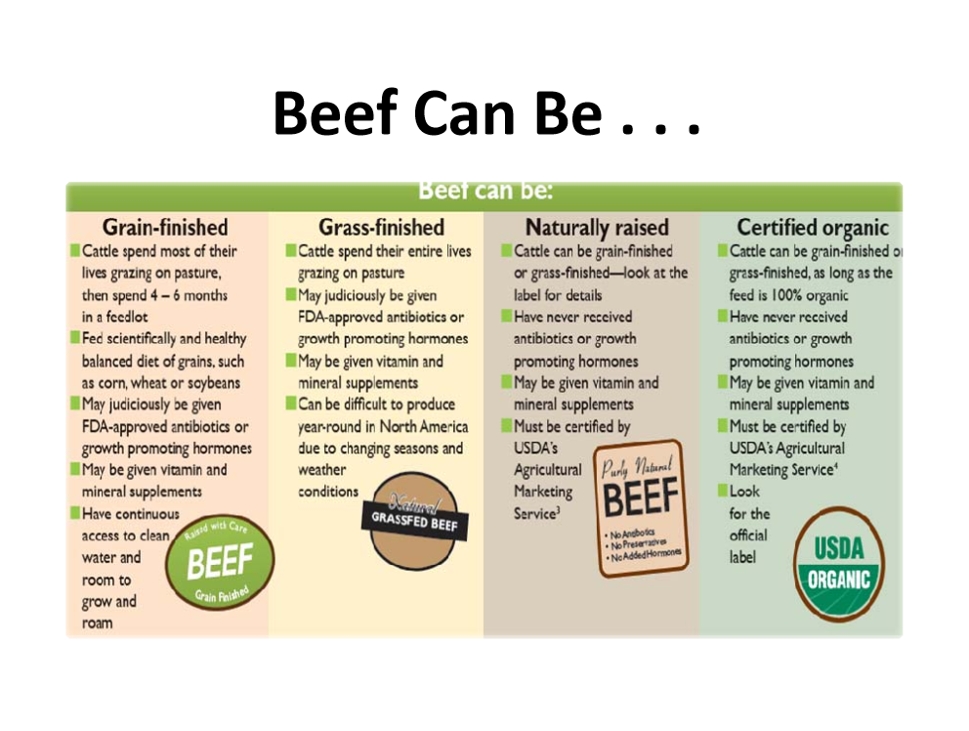

Slide 14
Beef Slaughter
Think of beef slaughter and fabrication as a disassembly plant – take a new car, chop it up, & sell parts all over the world
Cost of slaughter and fabrication is ~$200 ±$50/head in U.S.
        Labor is largest cost (24%)
        Packaging is second largest (12%)
26 plants currently slaughter and fabricate 33.9M fed cattle and 6M cows are consumed in U.S./yr
~100k fed cattle and 20k cows are harvested/day in U.S.
In 2014, of the 33.9M cattle produced, 20% retained for breeding, 75% harvested for beef, and 5% died before harvest = 52.5 lbs/capita consumption

Slide 15
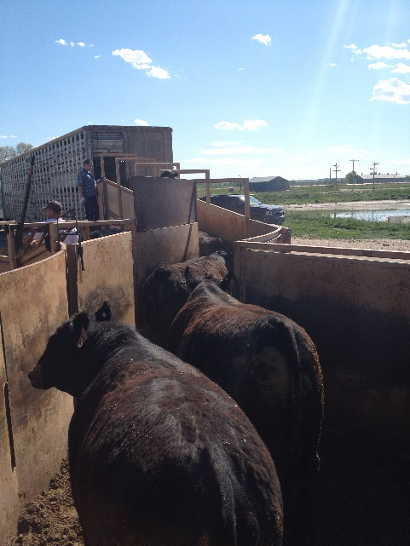
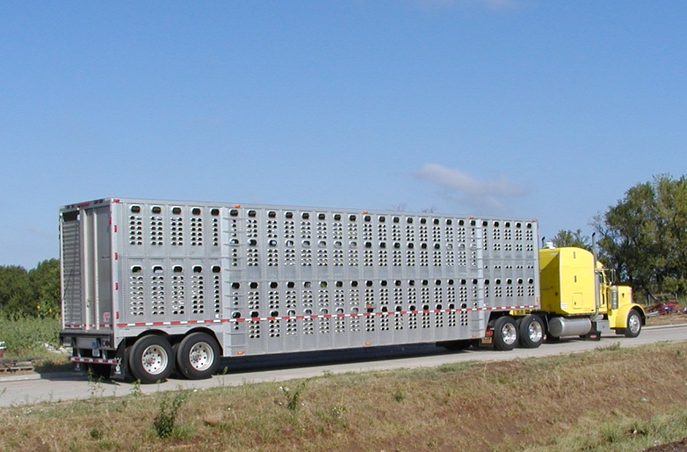
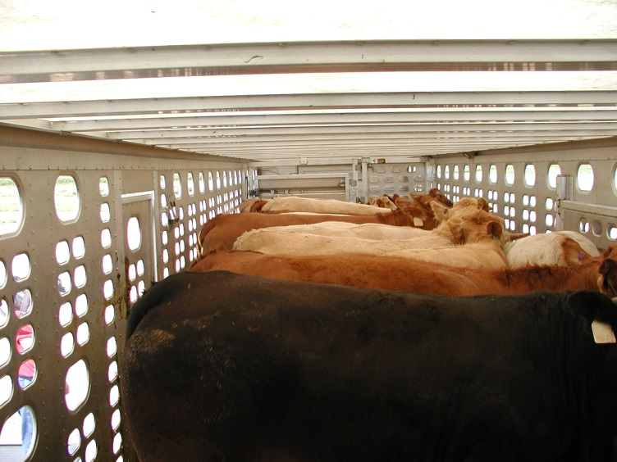
Transport

Slide 16
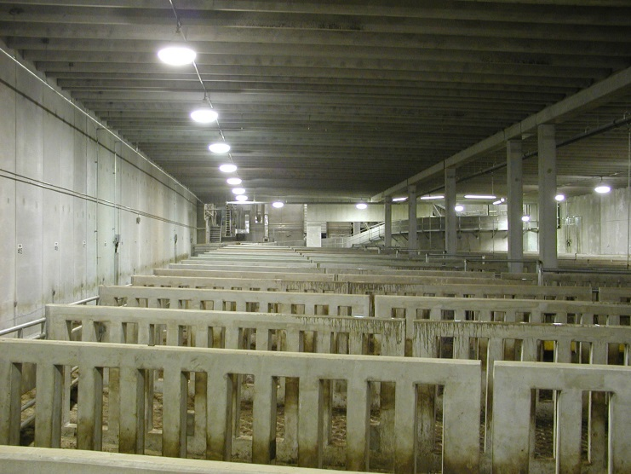
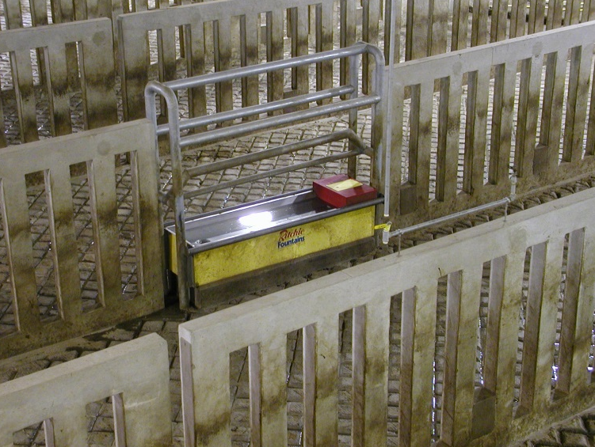
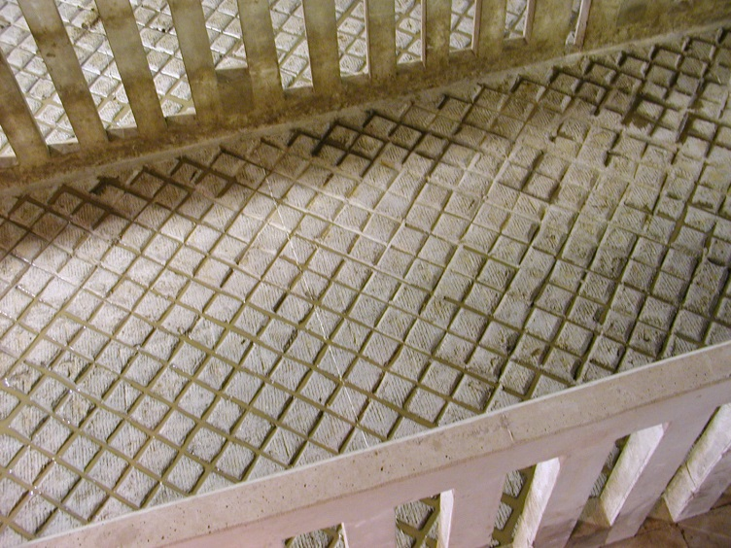
Holding Pens
Notes:
Pens designed y the nation’s foremost expert on animal behavior and welfare, Dr. Temple Grandin
Clean to dirty plant airflow pens cleaned between cattle one-way cattle traffic cattle laying down/ at rest one truck/one pen/ traceable ???

Slide 17
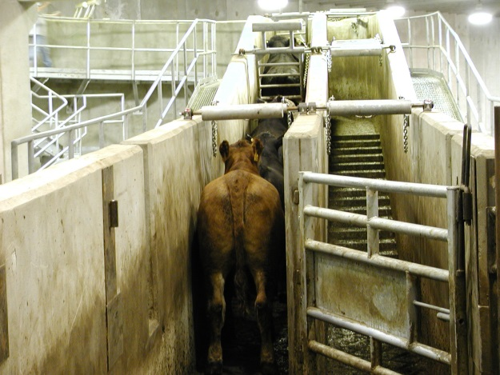
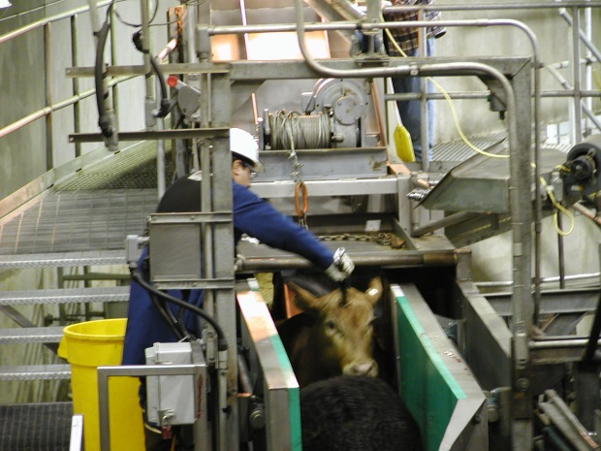
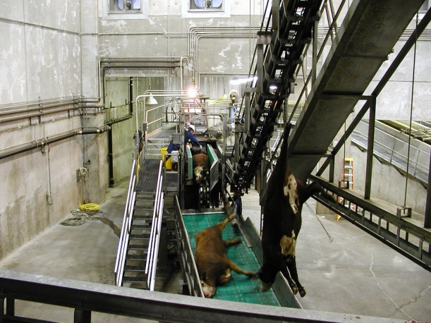
Loading
Stunning
Bleeding

Slide 18
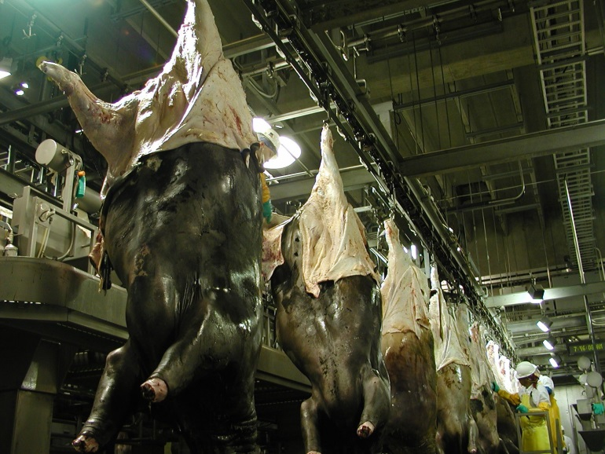
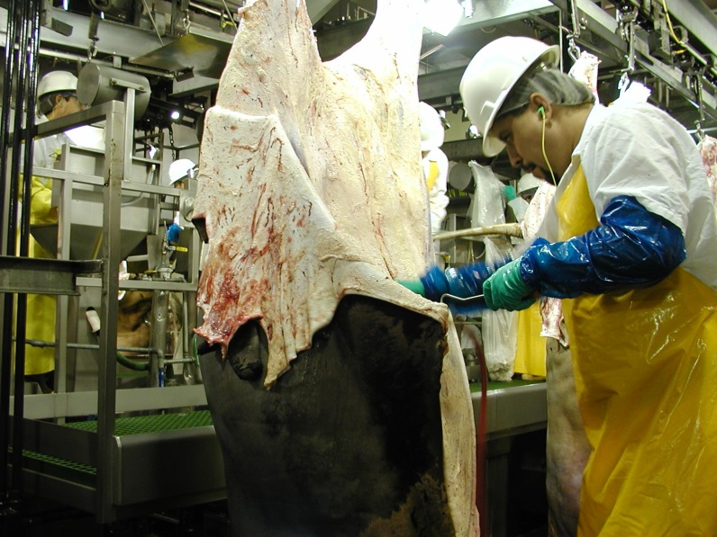
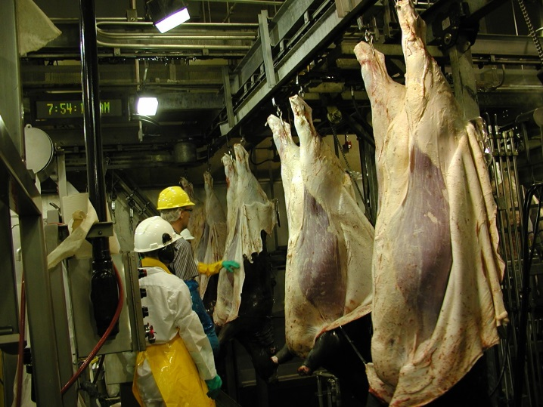
Hide Removal

Slide 19
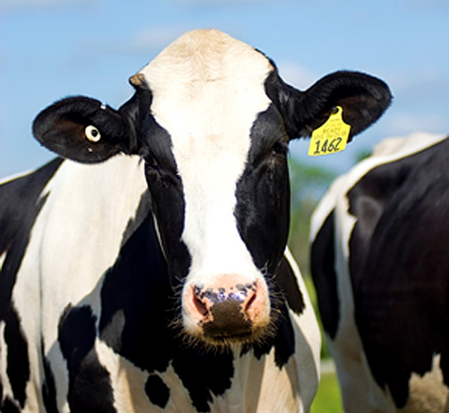
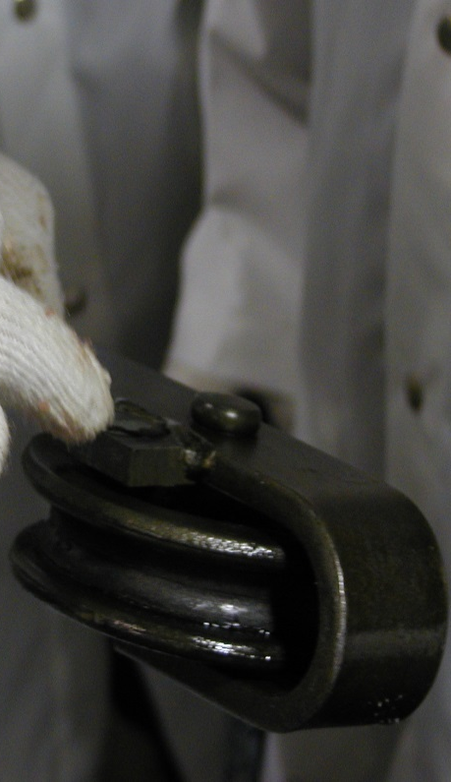
ID Tracking
Individual electronic ID transferred from ear tag to trolley chip and read by trolley readers throughout the plant and to the package

Slide 20
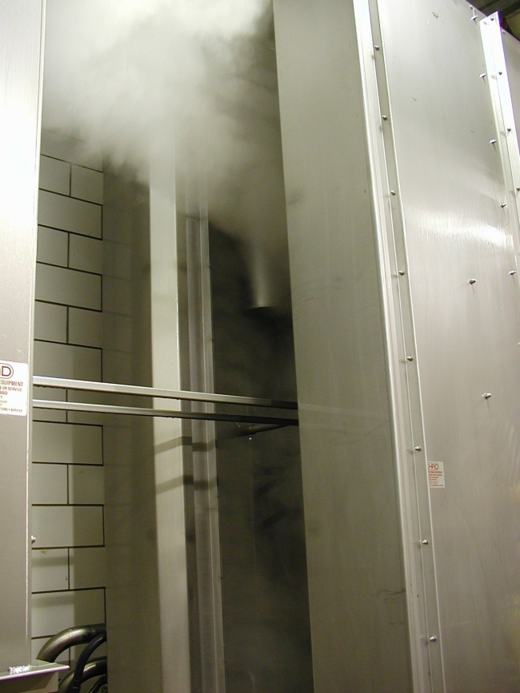
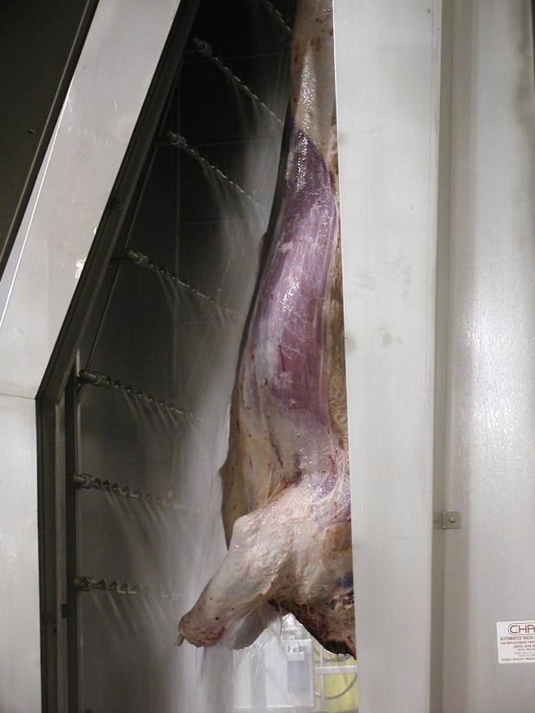
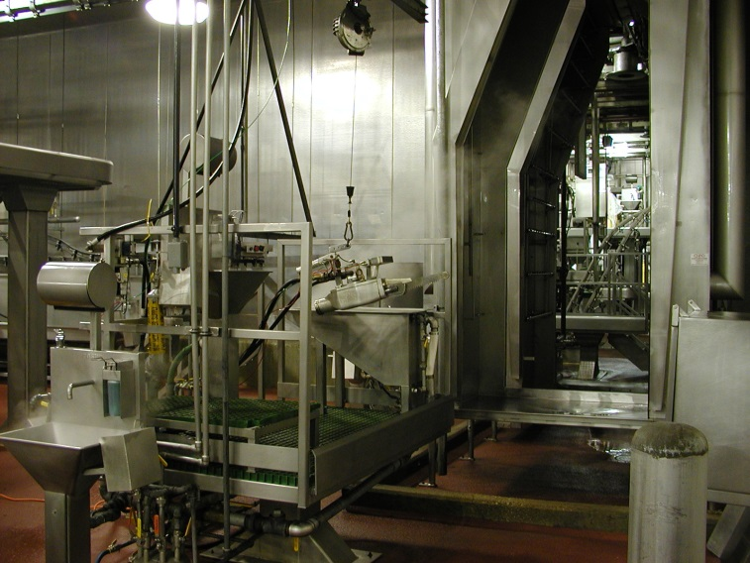
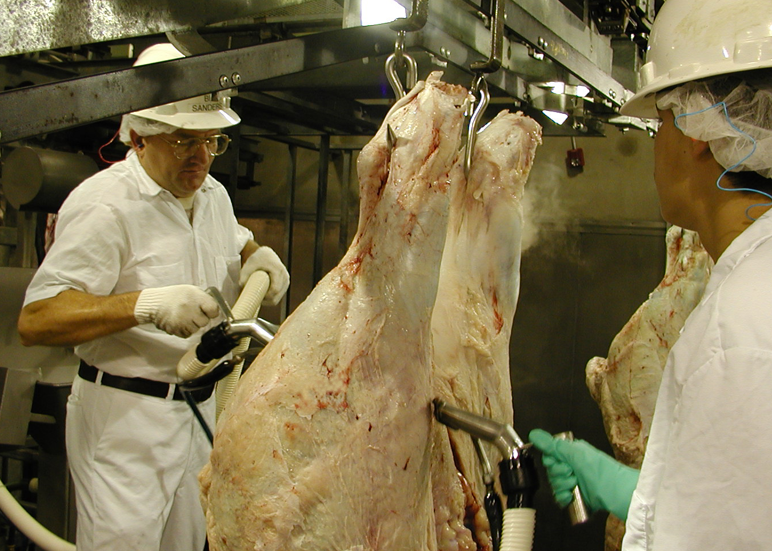
Carcass/ Interventions

Slide 21
Clean Side Processing

Slide 22
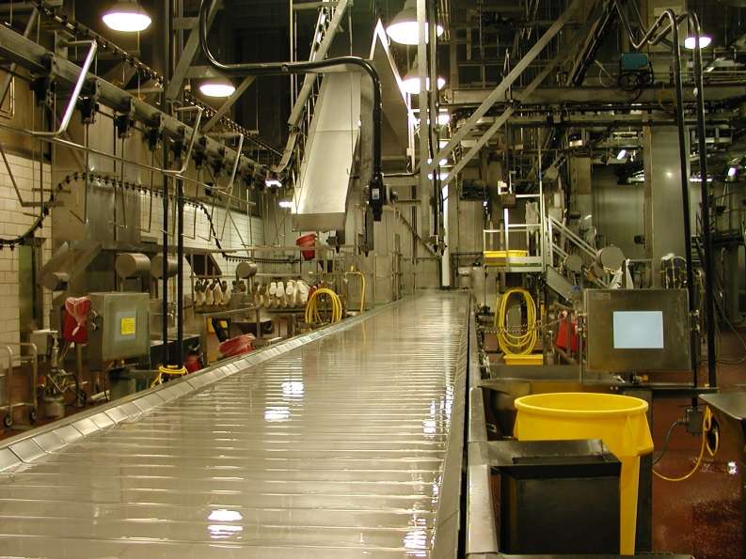
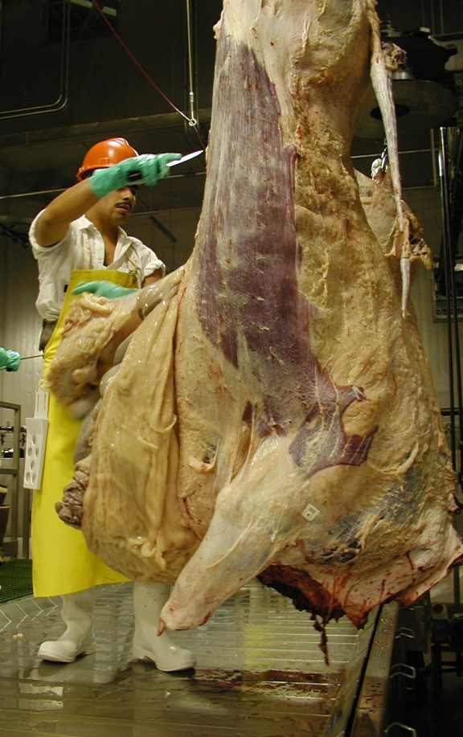
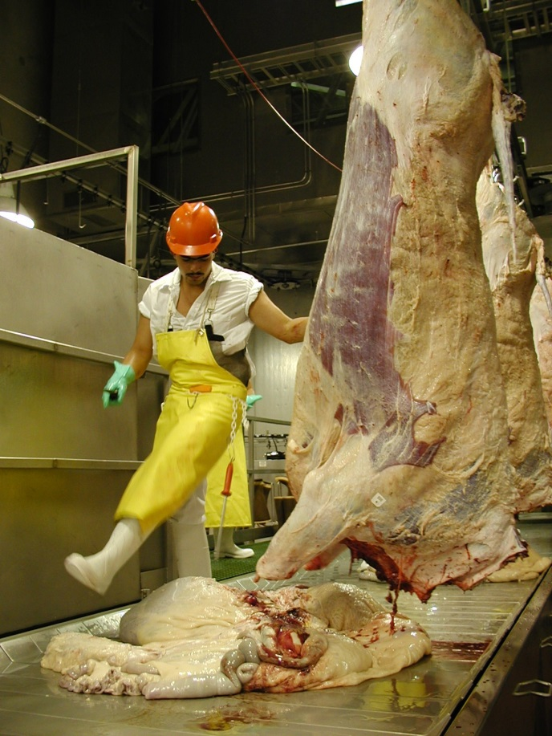
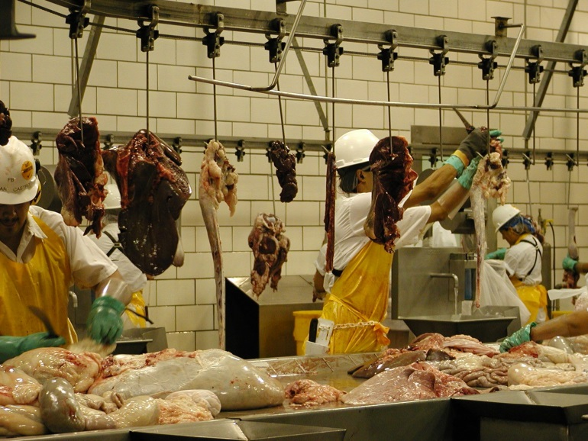
Offal Removal / USDA Inspection

Slide 23
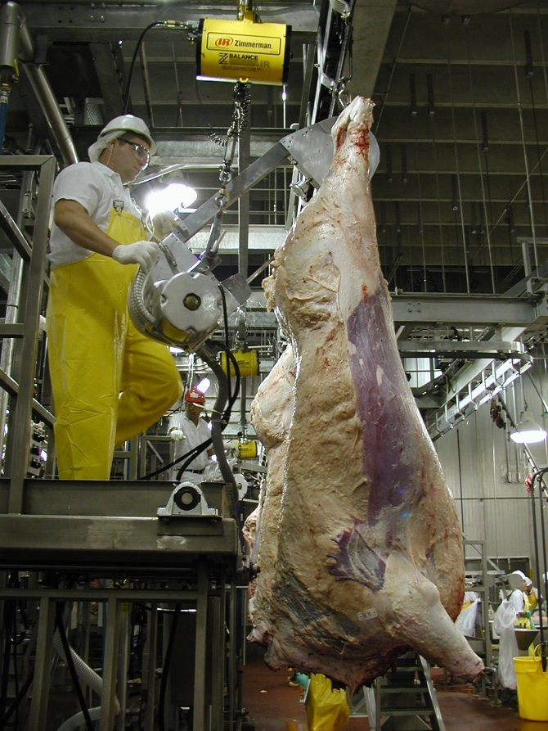
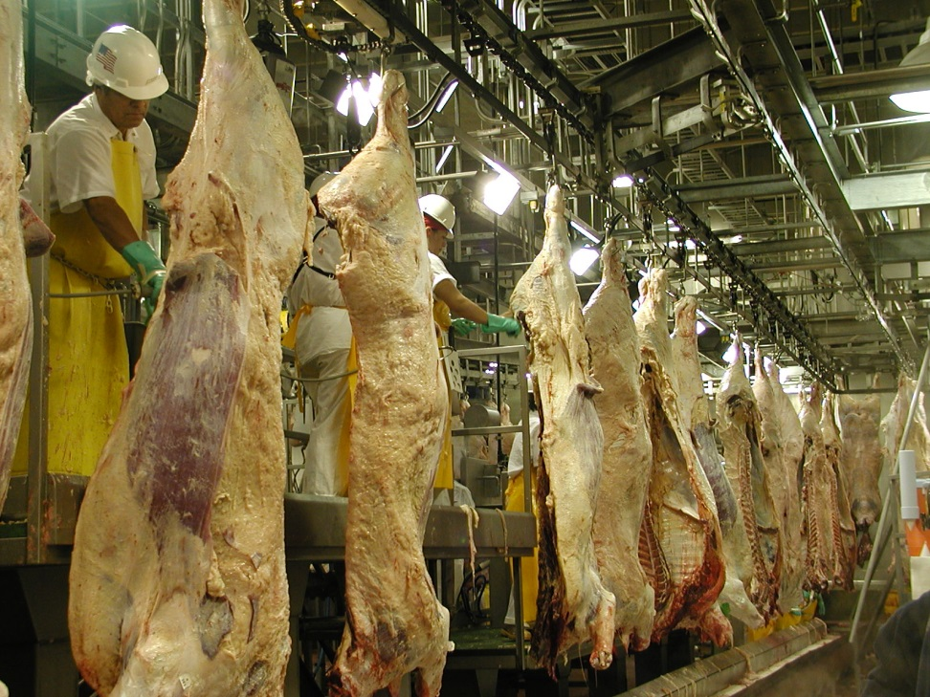
FSIS Inspection
Splitting

Slide 24
Electrical Stimulation
250volts / 6 amps / 25 pulses / post slaughter
Acceleration of muscle natural aging process
Muscle stimulation lowers pH from 7.0 to 5.6 while carcass temperature is still high, promoting greater enzyme activity
Improves tenderness by 20%-25% on fed cattle
Improves muscle color

Slide 25
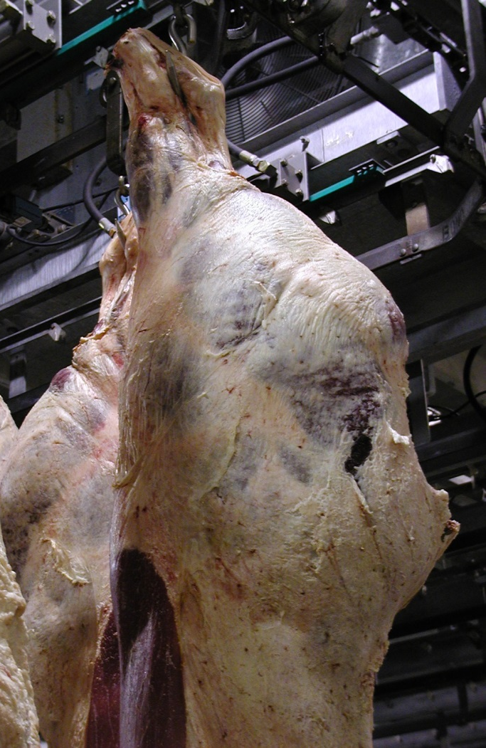
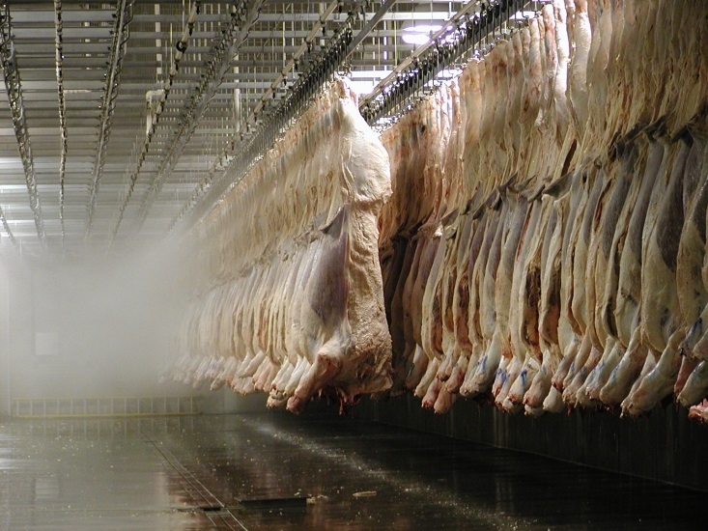
Hot Box

Slide 26

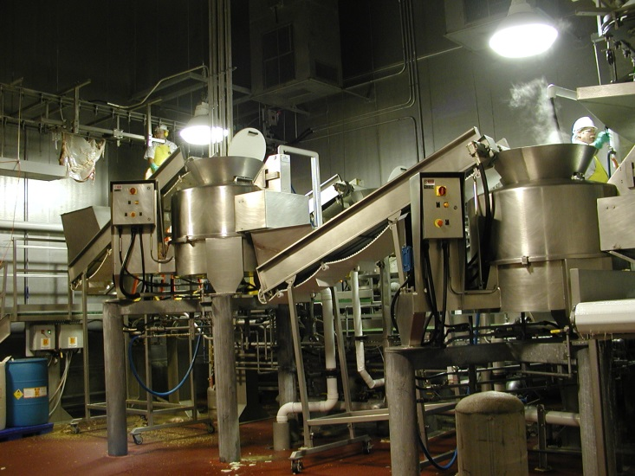
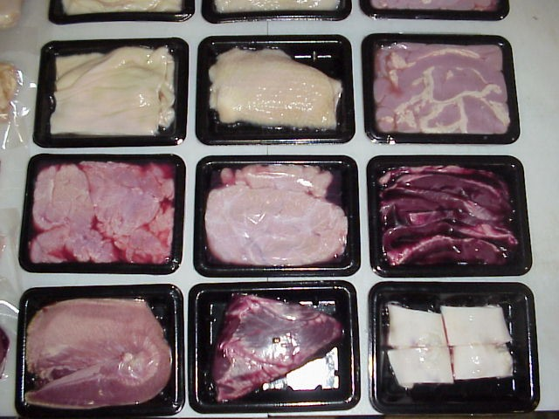
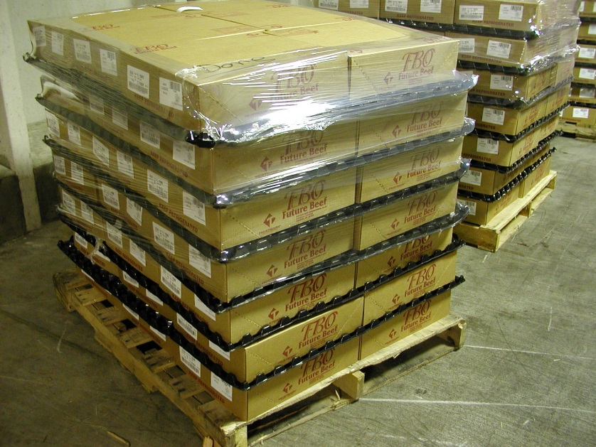
Variety Meats

Slide 27
By-Product Value
 |  |  |  |  | 200
 | BY-PRODUCT TOTAL |  | YIELD |  | LB / HD |  | $ / LB |  | $ / HD
 | EDIBLE TALLOW |  | 20% |  | 40 |  | $ 0.4850 |  | $ 23.25
 | MEAT & BONE MEAL |  | 30% |  | 60 |  | $ 0.2389 |  | $ 14.95
 | BLOOD MEAL |  | 12% |  | 5.4 |  | $ 0.7570 |  | $ 4.09
 | HOT WATER SAVINGS |  |  |  |  |  |  |  | $ 1.20
 | RENDERING TOTAL |  |  |  | 105.4 |  |  |  | $ 43.49
 | NATIVE HIDE |  |  |  |  |  |  |  | $ 86.56
 | BRANDED HIDE |  |  |  | 10% |  |  |  | $ 74.00
 | HIDE VALUE-ADDED |  | 60% |  | 130 | GREEN |  |  | $ 12.56
 |  |  |  |  | 78 | SALT-CURED
 |  |  |  |  | 20 | SALT
 | BY-PRODUCT VALUE-ADDED |  |  |  |  |  |  |  | $ 130.05
 | TOTAL EDIBLE OFFAL LB / HEAD |  |  |  |  |  |  |  | $ 101.17
 |  |  |  |  |  |  |  |  | $ 231.22
Rendering
By-products
Tallow or lard
Hides
Pet treats
Notes:
Rendering- using temperature to separate and cook the constituent parts: 1. grind together the fat, 2. cook the water off – 6-8% - supply of hot water for plant sanitation, 3. melt and decant the fat – becomes tallow or lard, 4. bone and muscle are ground together to create meat and bone meal – 50-55% protein
By-products- fed to hogs and chickens as a highly digestible form of protein and energy
Tallow or lard- bleached and used for human cooking oil – no trans fats until hydrogenated
Hides- salt-cured and shipped to tanneries in “show city” in china
More hides eaten as human protein than tanned for leather in africa, south america, and india
Pet treats are also a value-added category between hides, meat and bone meal, and tallow

Slide 28
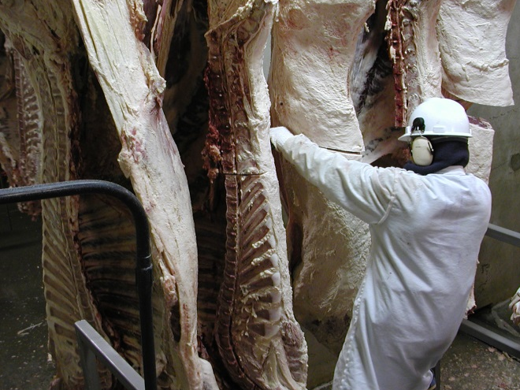
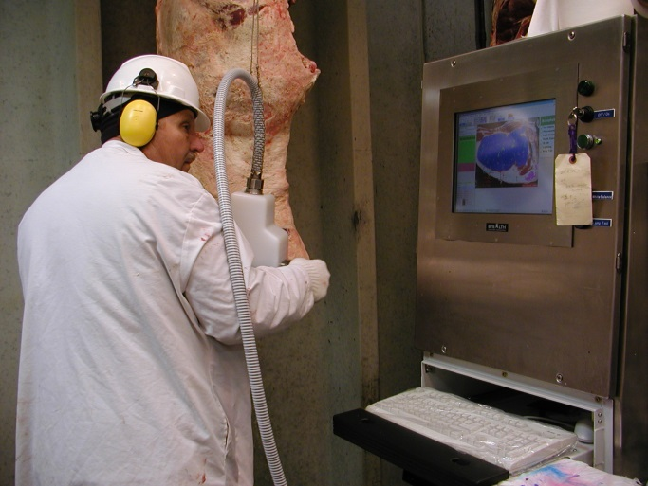
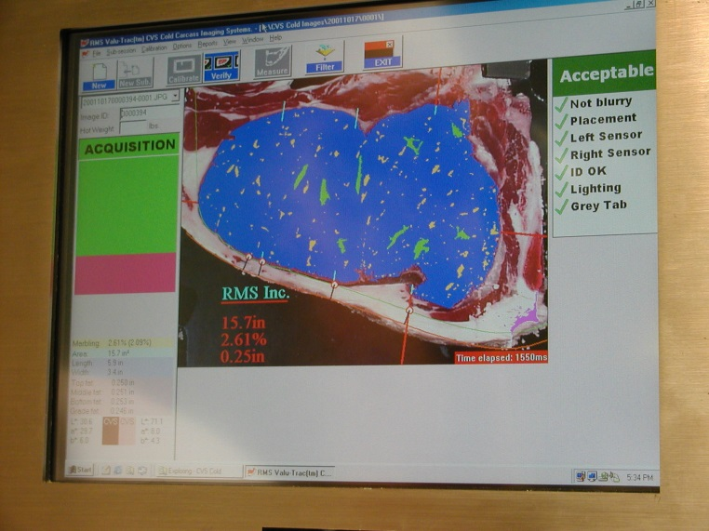
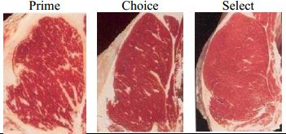
Grading Cooler

Slide 29
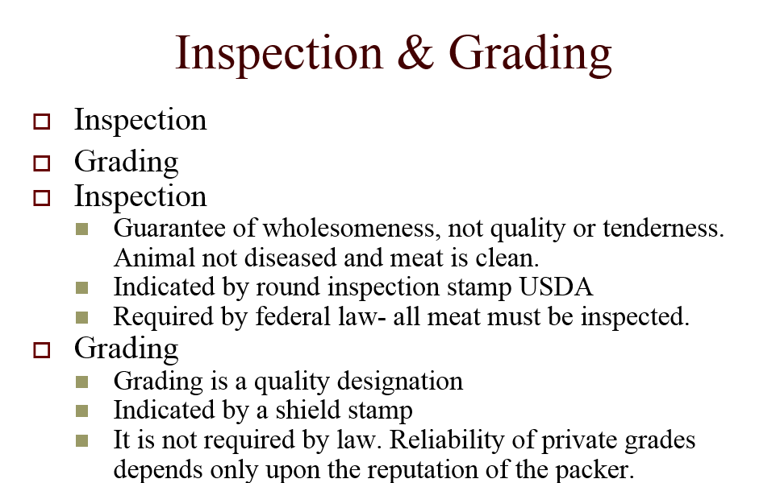

Slide 30
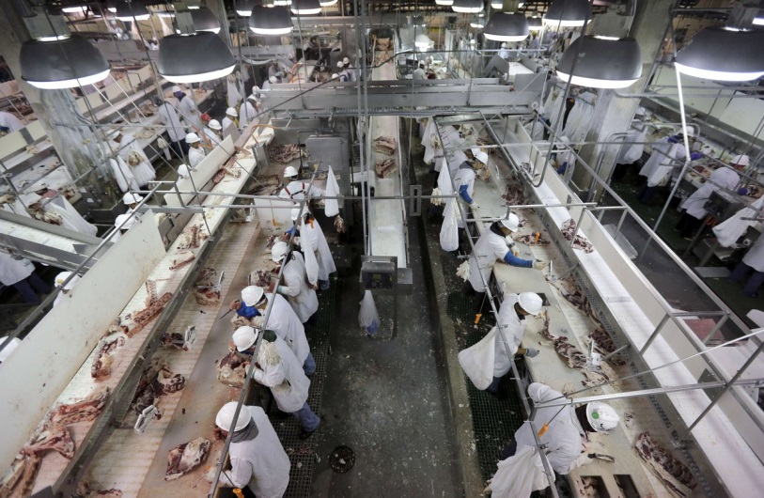
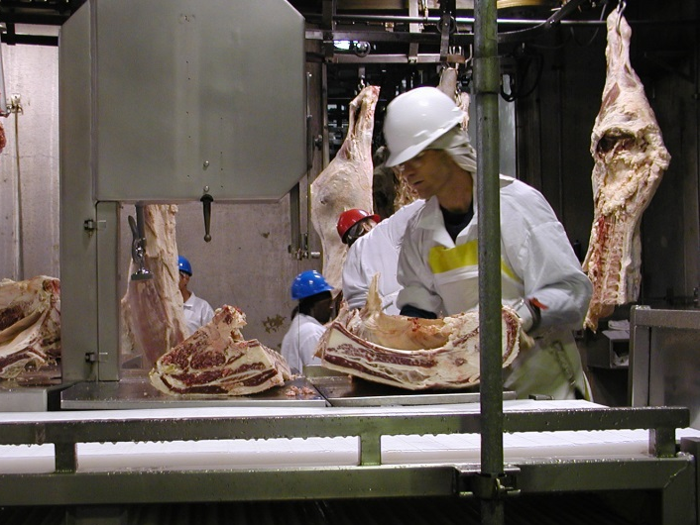
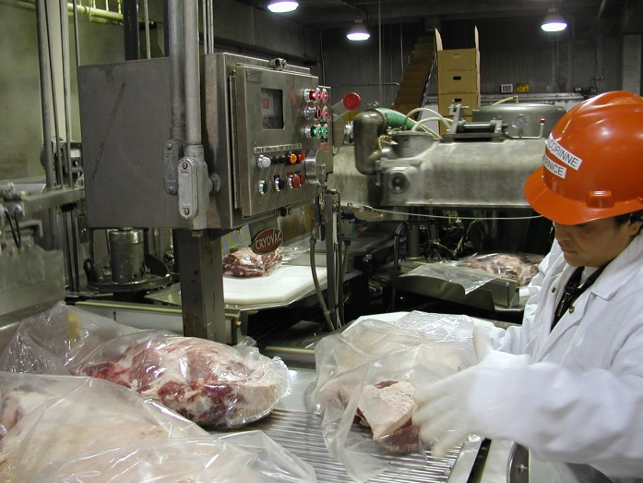
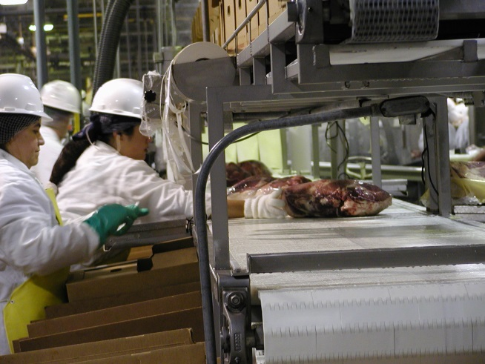
Fabrication
Vacuum Packaging
Pack-Off

Slide 31
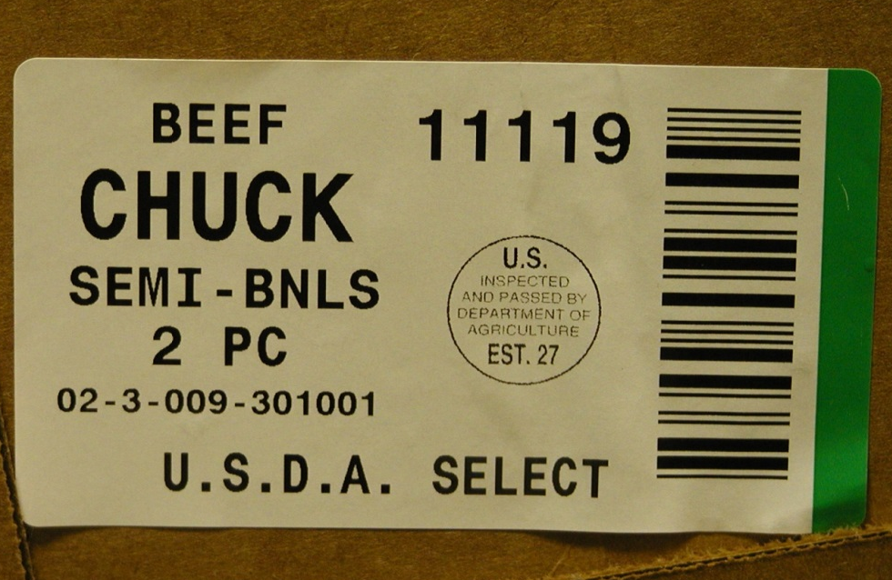

Tracking
Individual Pallet Identification Tags
Individual Box Scanning on Each Pallet
Green Label: USDA Select
Blue Label: USDA Choice

Slide 32

Beef Primal Cuts

Slide 33


Slide 34


Slide 35
Ground Beef Value

Slide 36




Ground Beef Processing
Ground beef processing and packaging in an electronic temperature controlled environment with CO2 bottom injection

Slide 37



National School Lunch Program Supplier Locations

Slide 38
Questions?
Bucky Gwartney | Rod Bowling
202-720-1424 | 202-750-0744
Bucky.Gwartney@ams.usda.gov | Rodney.Bowling@ams.usda.gov

